Slide 1
MLOPS
What, Why and How?

Slide 2
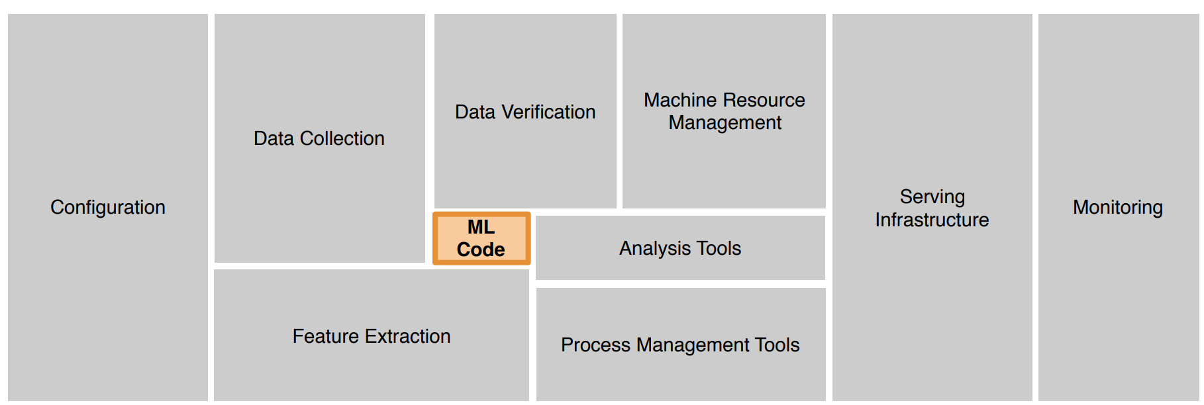
ML Infrastructure
[D. Sculley et. al. NIPS 2015: Hidden Technical Debt in Machine Learning Systems]

Slide 3
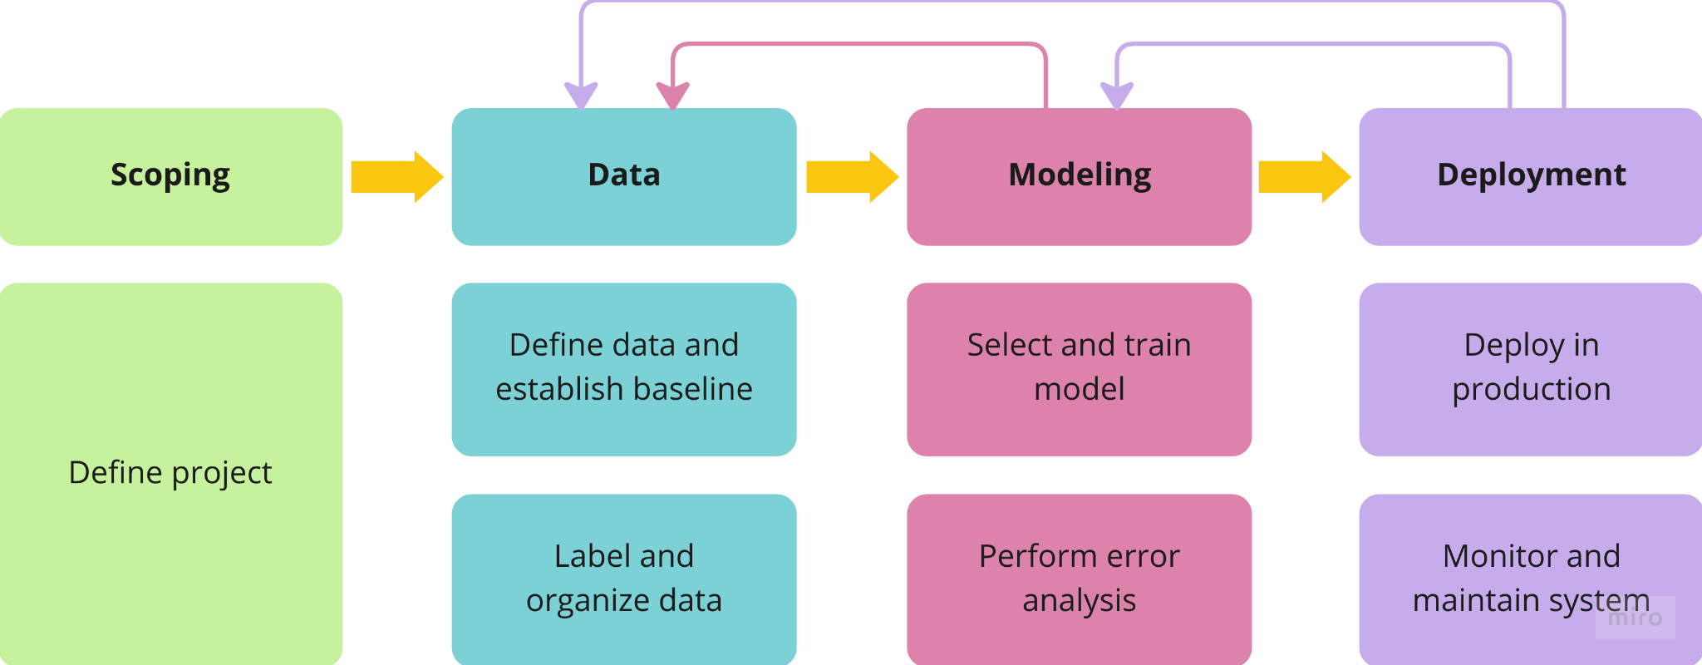
ML Project Lifecycle

Slide 4
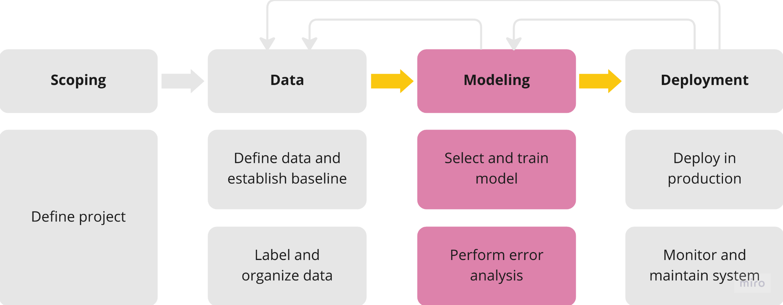
Modeling Overview

Slide 5
Selecting and training a model

Slide 6
Modeling Overview
Model-centric AI development
Notes:
Model-centric
The other one is data-centric which we will see later

Slide 7
Modeling Overview
Model-centric AI development
Selecting and training a model

Slide 8
Modeling Overview
Model-centric AI development
Selecting and training a model
Error analysis and performance auditing

Slide 9
Model development is iterative
Model + Hyperparameters + data

Slide 10
Model development is iterative
Model + Hyperparameters + data
Training

Slide 11
Model development is iterative
Model + Hyperparameters + data
Error analysis
Training

Slide 12
Model development is iterative
Model + Hyperparameters + data
Error analysis
Training

Slide 13
Challenges in model development
Achieving high accuracy / low error on test set is not sufficient
Notes:
Because it does not always cover the edge cases like rare classes or skewed datasets
More in a bit
User will forgive for informational queries like “Apple pie recipe”, “Latest movies” but not for navigational “Stanford”, “Youtube”.
If a model performs well on informational but slightly bad on navigational, it will lose the trust of the user
In medical data, if you have 99% negative example and 1% positive, then model will achieve 99% accuracy by just outputting negative
ML loan approval -> no discrimination
Product recommender -> treats all users ,retailers, products fairly
Chest xray conditions, some are more common then others
If you ignore uncommon ones, accuracy will still be high => problem
My thesis
Medical data scarcity

Slide 14
Challenges in model development
Achieving high accuracy / low error on test set is not sufficient
Performance on important examples
Notes:
Because it does not always cover the edge cases like rare classes or skewed datasets
More in a bit
User will forgive for informational queries like “Apple pie recipe”, “Latest movies” but not for navigational “Stanford”, “Youtube”.
If a model performs well on informational but slightly bad on navigational, it will lose the trust of the user
In medical data, if you have 99% negative example and 1% positive, then model will achieve 99% accuracy by just outputting negative
ML loan approval -> no discrimination
Product recommender -> treats all users ,retailers, products fairly
Chest xray conditions, some are more common then others
If you ignore uncommon ones, accuracy will still be high => problem
My thesis
Medical data scarcity

Slide 15
Challenges in model development
Achieving high accuracy / low error on test set is not sufficient
Performance on important examples
No discriminations based on ethnicity, gender, location, language.
Notes:
Because it does not always cover the edge cases like rare classes or skewed datasets
More in a bit
User will forgive for informational queries like “Apple pie recipe”, “Latest movies” but not for navigational “Stanford”, “Youtube”.
If a model performs well on informational but slightly bad on navigational, it will lose the trust of the user
In medical data, if you have 99% negative example and 1% positive, then model will achieve 99% accuracy by just outputting negative
ML loan approval -> no discrimination
Product recommender -> treats all users ,retailers, products fairly
Chest xray conditions, some are more common then others
If you ignore uncommon ones, accuracy will still be high => problem
My thesis
Medical data scarcity

Slide 16
Challenges in model development
Achieving high accuracy / low error on test set is not sufficient
Performance on important examples
No discriminations based on ethnicity, gender, location, language.
Treats all users, retailers and product categories fairly
Notes:
Because it does not always cover the edge cases like rare classes or skewed datasets
More in a bit
User will forgive for informational queries like “Apple pie recipe”, “Latest movies” but not for navigational “Stanford”, “Youtube”.
If a model performs well on informational but slightly bad on navigational, it will lose the trust of the user
In medical data, if you have 99% negative example and 1% positive, then model will achieve 99% accuracy by just outputting negative
ML loan approval -> no discrimination
Product recommender -> treats all users ,retailers, products fairly
Chest xray conditions, some are more common then others
If you ignore uncommon ones, accuracy will still be high => problem
My thesis
Medical data scarcity

Slide 17
Challenges in model development
Achieving high accuracy / low error on test set is not sufficient
Performance on important examples
No discriminations based on ethnicity, gender, location, language.
Treats all users, retailers and product categories fairly
Rare classes
Medical data
Notes:
Because it does not always cover the edge cases like rare classes or skewed datasets
More in a bit
User will forgive for informational queries like “Apple pie recipe”, “Latest movies” but not for navigational “Stanford”, “Youtube”.
If a model performs well on informational but slightly bad on navigational, it will lose the trust of the user
In medical data, if you have 99% negative example and 1% positive, then model will achieve 99% accuracy by just outputting negative
Skewed datasets
More on that later
ML loan approval -> no discrimination
Product recommender -> treats all users ,retailers, products fairly
Chest xray conditions, some are more common then others
If you ignore uncommon ones, accuracy will still be high => problem
My thesis
Medical data scarcity
Very challenging

Slide 18
Establish a baseline
Speech recognition example
Type | Accuracy
Clear Speech | 94%
Car Noise | 89%
People Noise | 87%
Low Bandwidth | 70%
Notes:
Can you guess where is more room for improvement?

Slide 19
Establish a baseline
Speech recognition example
Type | Accuracy | HLP | Difference
Clean Speech | 94% | 95% | 1%
Car Noise | 89% | 93% | 4%
People Noise | 87% | 89% | 2%
Low Bandwidth | 70% | 70% | 0%
Notes:
You need to know the “gap to HLP/baseline” to decide that!
If even a human cannot have more accuracy than that, then it might be a waste of time to try to improve that tag

Slide 20
Structured vs. Unstructured data
Notes:
HLP can help in unstructured because humans are used to such data
It’s intuitive

Slide 21



Structured vs. Unstructured data
Unstructured data
Image
Audio
Text
Notes:
HLP can help in unstructured because humans are used to such data
It’s intuitive

Slide 22
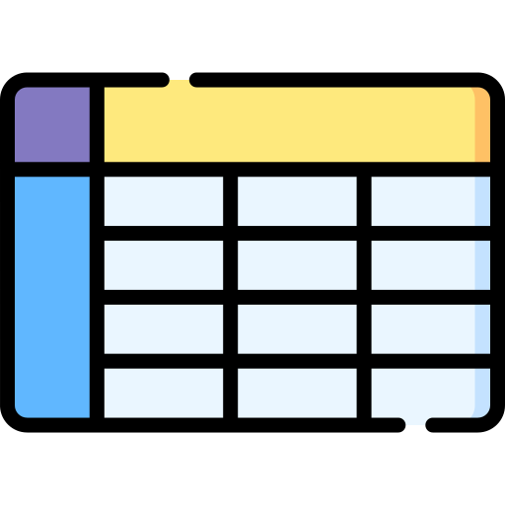

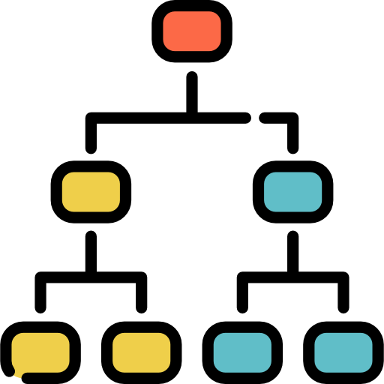
Structured vs. Unstructured data
Unstructured data
Image
Audio
Text
Structured data
Notes:
HLP can help in unstructured because humans are used to such data
It’s intuitive

Slide 23
Ways to establish a baseline
Human level performance (less useful in structured data)

Slide 24
Ways to establish a baseline
Human level performance (less useful in structured data)
Literature search (SOTA)

Slide 25
Ways to establish a baseline
Human level performance (less useful in structured data)
Literature search (SOTA)
Quick and dirty implementation
Notes:
Quick and dirty
You get initial rought result which give you some estimate/baseline
Then you try to improve it

Slide 26
Ways to establish a baseline
Human level performance (less useful in structured data)
Literature search (SOTA)
Quick and dirty implementation
Performance of an older system

Slide 27
Ways to establish a baseline
Human level performance (less useful in structured data)
Literature search (SOTA)
Quick and dirty implementation
Performance of an older system
Baseline helps to indicate what might be possible. In some cases (as in HLP), it also give a sense of what is Bayes error.
Notes:
Bayes/irreducible error is the minimum possible error that we can achieve

Slide 28
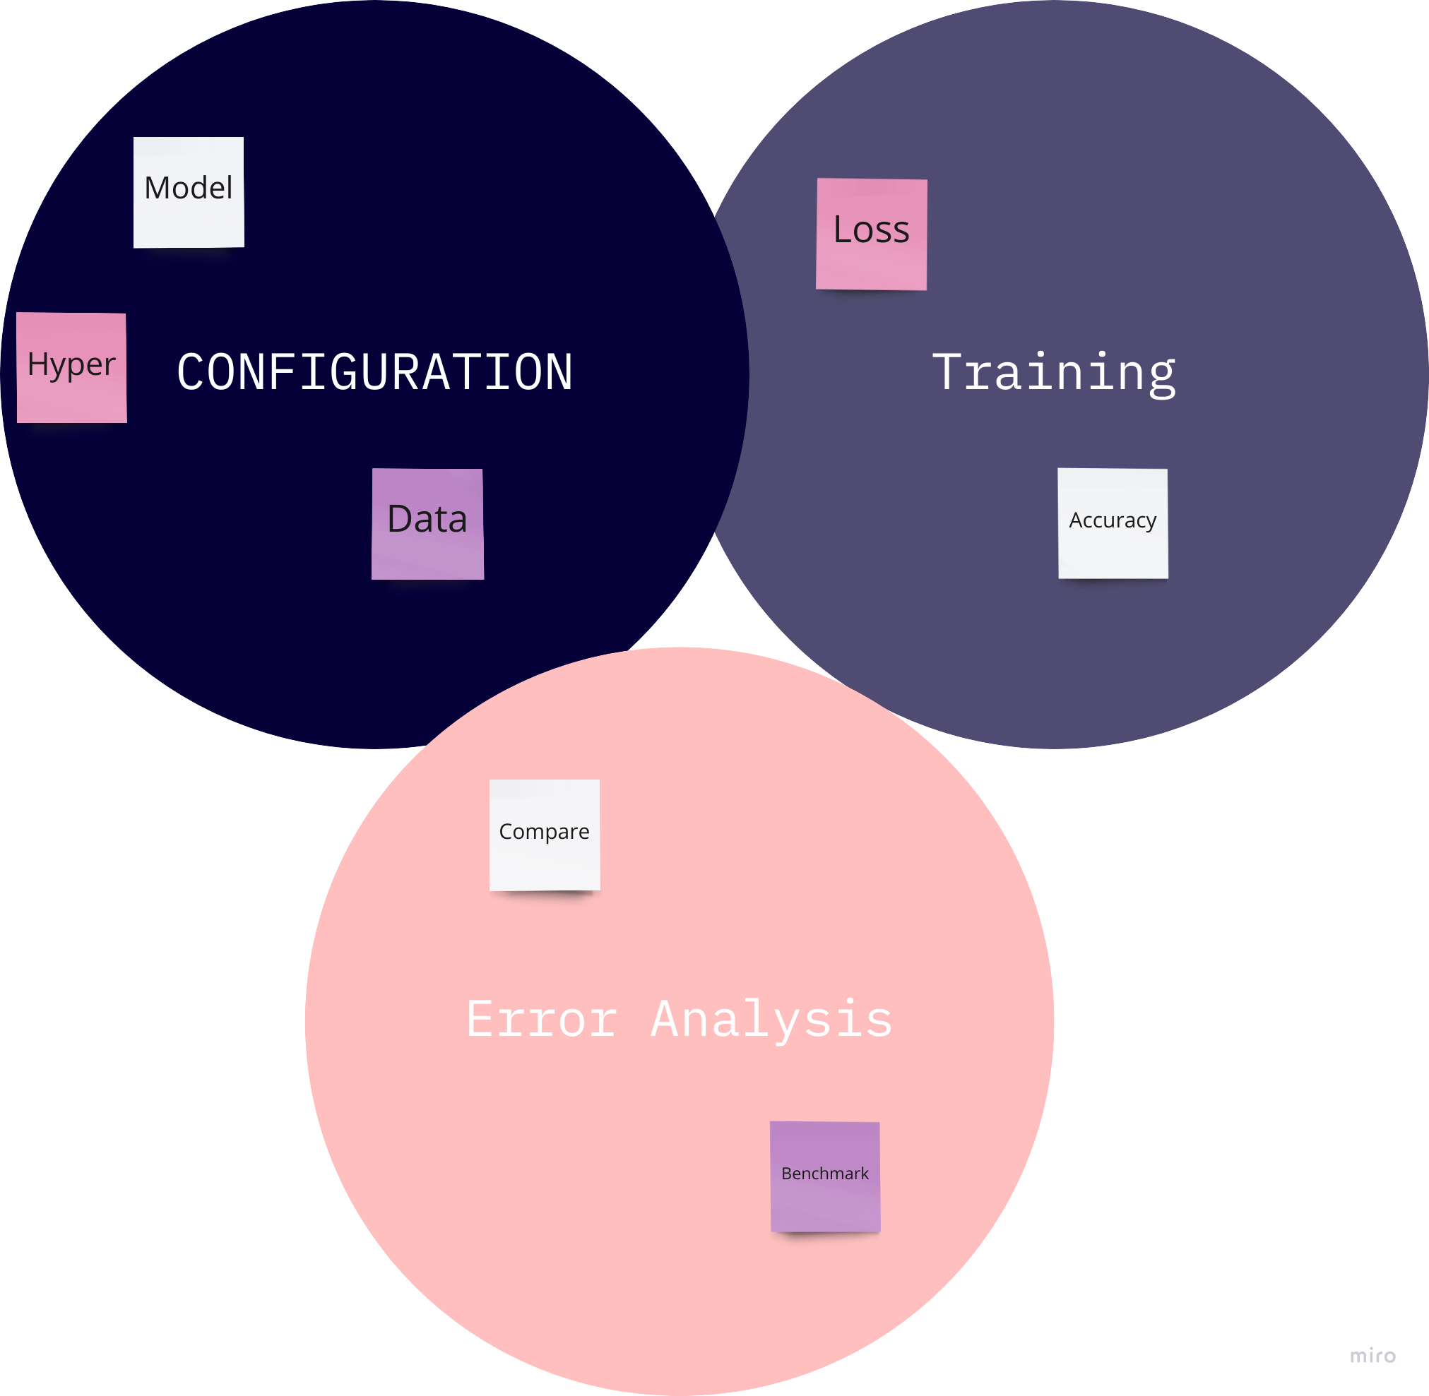
Tips on getting started
Notes:
So normally this is how we start
We define configs
Train the model
Error analysis
And repeat

Slide 29
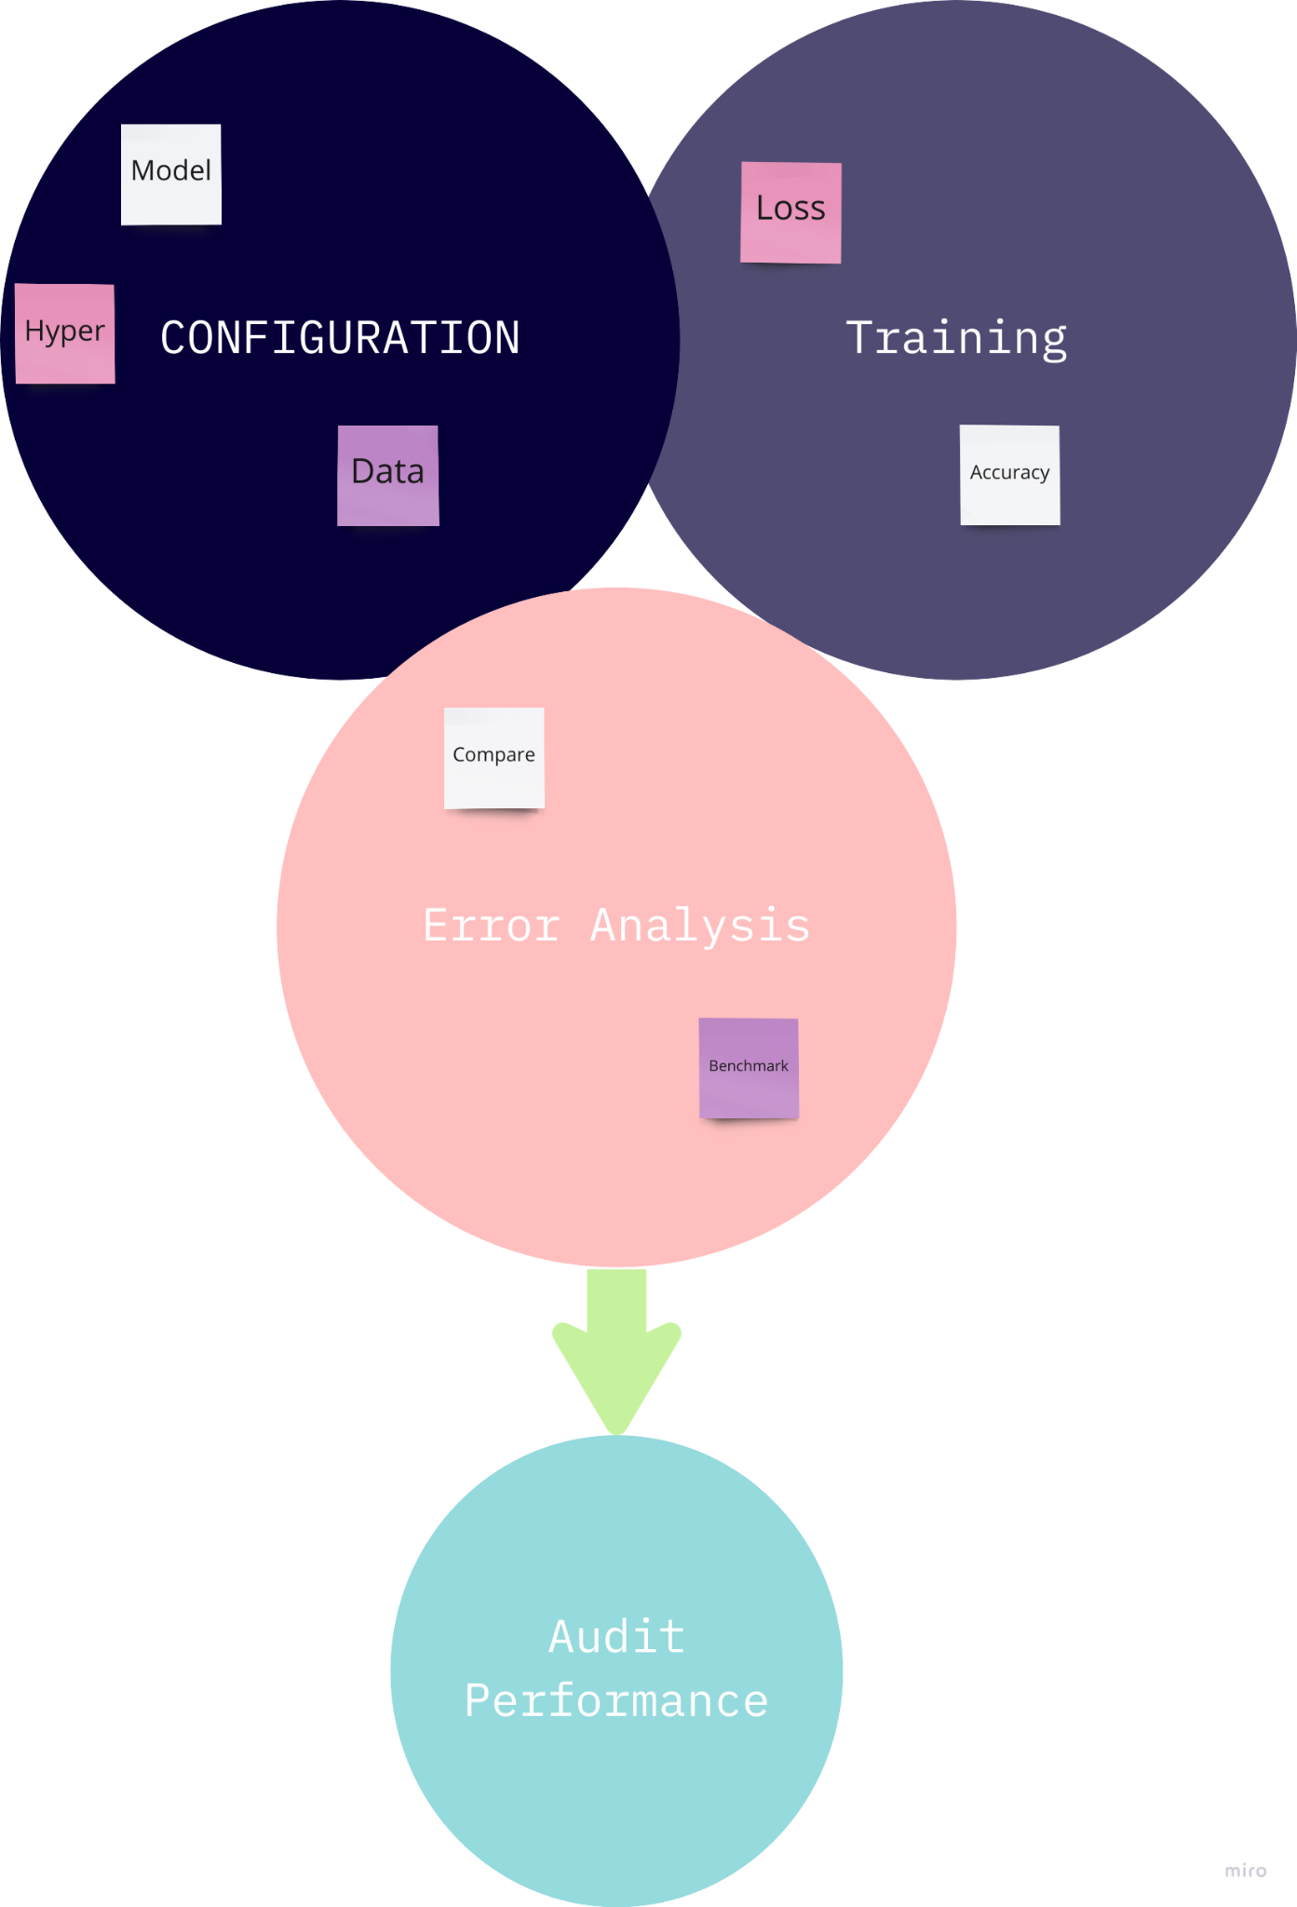
Tips on getting started
Notes:
Audit the performance before taking it into production

Slide 30
Tips on getting started
Literature search to see what is possible
Notes:
Literature search to see what is possible (courses, blogs, papers, open-source projects)

Slide 31
Tips on getting started
Literature search to see what is possible
Find open-source implementations
Notes:
Literature search to see what is possible (courses, blogs, papers, open-source projects)

Slide 32
Tips on getting started
Literature search to see what is possible
Find open-source implementations
Reasonable algorithm with good data > great algorithm with not so good data
Notes:
Literature search to see what is possible (courses, blogs, papers, open-source projects)

Slide 33
Deployment constraints when picking a model
Should you consider deployments constraints when picking a model?

Slide 34
Deployment constraints when picking a model
Should you consider deployments constraints when picking a model?
YES!
If baseline is already established and goal is to build and deploy.

Slide 35
Deployment constraints when picking a model
Should you consider deployments constraints when picking a model?
YES!
If baseline is already established and goal is to build and deploy.
NOT NECESSARY!
If purpose is to establish a baseline and determine what is possible and might be worth pursuing.

Slide 36
Sanity check for code and algorithm
Try to overfit on a small training dataset before training on a large one

Slide 37
Error analysis and performance auditing

Slide 38
Error analysis example
Speech recognition example
Example | Label | Prediction | Car noise | People noise | Low Bandwidth
1 | “Stir fried lettuce recipe” | “Stir fry lettuce recipe” | 1
2 | “Sweetened coffee” | “Swedish coffee” |  | 1 | 1
3 | “Sail away song” | “Swell away some” |  | 1
4 | “Let’s catch up” | “Let’s ketchup” | 1 | 1 | 1
Notes:
This is manual process
Jupyter notebook
Spreadsheets
There are also emerging MLOps tools to do this analysis

Slide 39
Iterative process of error analysis
Examine/ tag examples => Propose new tags
Visual inspection
Image properties
Defect type (scratch or dent)
Notes:
Examine the examples with issues, check tags
This is manual process
Jupyter notebook
Spreadsheets
There are also emerging MLOps tools to do this analysis
Image properties
Blurry
Dark or light background
Reflection
Etc.
Meta data
Phone model
Factory
Goal is to come up with categories that improve our algorithm

Slide 40
Useful metric for each tag
What fraction of errors has that tag?
Of all the data with that tag, what fraction is misclassified
What fraction of all that data has that tag
How much room for improvement is there on data with that tag
Remember HLP?
Notes:
How important is it to work on a specific tag like “Car noise”
Also tells you how much you can improve by fixing all the car noise tag predictions

Slide 41
Prioritizing what to work on
Type | Accuracy | HLP | Difference
Clean Speech | 94% | 95% | 1%
Car Noise | 89% | 93% | 4%
People Noise | 87% | 89% | 2%
Low Bandwidth | 70% | 70% | 0%
Notes:
Same question again -> can you tell me where is more room for improvement?
Or what was it the last time?
So since the difference is larger, it might be worth pursuing right?
NO!
Why is that? Can you guess?

Slide 42
Prioritizing what to work on
Type | Accuracy | HLP | Difference | % of data
Clean Speech | 94% | 95% | 1% | 60%
Car Noise | 89% | 93% | 4% | 4%
People Noise | 87% | 89% | 2% | 30%
Low Bandwidth | 70% | 70% | 0% | 6%
Notes:
You need to know data distribution to decide that!
If we can increase clean speech from 94% to 95% => overall system 0.6% better
On car noise, if we increase by 4% => 0.16%
People noise => 0.6%
Low Bandwidth => 0%
Maybe more worthwhile to work on either “people noise” or “clean speech”

Slide 43
Prioritizing what to work on
Decide most important categories

Slide 44
Prioritizing what to work on
Decide most important categories
How much room for improvement

Slide 45
Prioritizing what to work on
Decide most important categories
How much room for improvement
How frequently that category appears

Slide 46
Prioritizing what to work on
Decide most important categories
How much room for improvement
How frequently that category appears
How easy it is to improve accuracy in that category

Slide 47
Prioritizing what to work on
Decide most important categories
How much room for improvement
How frequently that category appears
How easy it is to improve accuracy in that category
How important is it to improve that category
Notes:
Some categories are more important for the application than the rest

Slide 48
Prioritizing what to work on
Decide most important categories
How much room for improvement
How frequently that category appears
How easy it is to improve accuracy in that category
How important is it to improve that category
Like “car noise”
Searching map directions while driving is important

Slide 49
Adding/improving data for specific categories
Collect more data
Data augmentation
Improve label accuracy / data quality
Notes:
More on label and data quality later

Slide 50
Skewed datasets
Highly imbalanced
Notes:
Skewed data
Medical with 99% negative
Manufacturing example with 98% no defect etc.
Speech recognition => example with no wake word 97%
Accuracy is useless. Even print(“0”) can achieve very high accuracy -> 99%
But if you take a deeper look, your recall is 0 and your precision is undefined

Slide 51
Skewed datasets
Highly imbalanced
Accuracy is not a good measure!
Notes:
Skewed data
Medical with 99% negative
Manufacturing example with 98% no defect etc.
Speech recognition => example with no wake word 97%
Accuracy is useless. Even print(“0”) can achieve very high accuracy

Slide 52
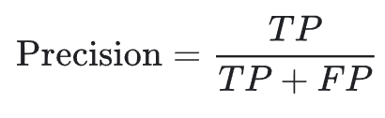
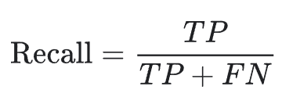
Skewed datasets
Highly imbalanced
Accuracy is not a good measure!
Confusion matrix, Precision, Recall, F1-score
Notes:
Skewed data
Medical with 99% negative
Manufacturing example with 98% no defect etc.
Speech recognition => example with no wake word 97%
Accuracy is useless. Even print(“0”) can achieve very high accuracy
Precision => What proportion of positive identifications was actually correct?
Recall => What proportion of actual positives was identified correctly?
Medical data with 99% negative examples
Print(0) => 99% accuracy
But precision is undefined and recall is 0
F1-score is also zero

Slide 53
Performance audit
Check for accuracy, fairness/bias and other problems
Brainstorm the ways the system might go wrong
Performance on subsets of data
How common are certain errors (e.g., FP, FN)
Performance on rare classes
Establish metrics to access performance against these issues on appropriate slices of data
[https://developers.google.com/machine-learning/crash-course/fairness/types-of-bias]
Notes:
Even if the model has high accuracy and f1, perform one last audit
Can save future trouble
Many kinds of bias => selection bias, sampling bias, coverage bias and so on
You can see the link
Brainstorm ways the system might go wrong
Performance on subsets of data (individual ethnicity, gender etc.)
Establish metrics to access performance against these issues
Instead of evaluating on whole dev set, apply on subset/slice

Slide 54
Data iteration

Slide 55
Data-centric AI development
Model-centric view
Take the data you have, improve the model
Iteratively improve the code/model
Data-centric view
Use tools to improve data quality
This will allow multiple models to do well
Iteratively improve the data
Notes:
Error analysis made you focus on improving a certain category

Slide 56
Model-centric vs Data-centric
A lot of emphasis on how to choose the right architecture
High quality data is more important for practical projects
Tools to improve data

Slide 57
Data augmentation
Useful especially for unstructured data
Goal
Create examples that algorithm does poorly on
Humans (or other baseline) does well on
Notes:
If you create examples that algorithm already performs well on, then there won’t be any improvement in performance
If it is all noise or something => not helpful => even Humans cannot predict

Slide 58
Data augmentation
Useful especially for unstructured data
Goal
Create examples that algorithm does poorly on
Humans (or other baseline) does well on
Checklist
Notes:
If you create examples that algorithm already performs well on, then there won’t be any improvement in performance
If it is all noise or something => not helpful => even Humans cannot predict

Slide 59
Data augmentation
Useful especially for unstructured data
Goal
Create examples that algorithm does poorly on
Humans (or other baseline) does well on
Checklist
Are the examples realistic?
Notes:
If you create examples that algorithm already performs well on, then there won’t be any improvement in performance
If it is all noise or something => not helpful => even Humans cannot predict

Slide 60
Data augmentation
Useful especially for unstructured data
Goal
Create examples that algorithm does poorly on
Humans (or other baseline) does well on
Checklist
Are the examples realistic?
Can humans still recognize it?
Notes:
If you create examples that algorithm already performs well on, then there won’t be any improvement in performance
If it is all noise or something => not helpful => even Humans cannot predict

Slide 61
Data augmentation
Useful especially for unstructured data
Goal
Create examples that algorithm does poorly on
Humans (or other baseline) does well on
Checklist
Are the examples realistic?
Can humans still recognize it?
Is the algorithm currently doing poorly on this new data?
Notes:
If you create examples that algorithm already performs well on, then there won’t be any improvement in performance
If it is all noise or something => not helpful => even Humans cannot predict

Slide 62
Data iteration loop
Add/improve data
(hold model fixed)
Error analysis
Training

Slide 63
Can adding data hurt performance?

Slide 64
Can adding data hurt performance?
For unstructured data problems, if
The model is large (low bias)
Mapping x to y is clear
Notes:
Mapping x to y is clear
Humans can make accurate predictions

Slide 65
Can adding data hurt performance?
For unstructured data problems
The model is large (low bias)
Mapping x to y is clear
Then adding new data rarely hurts
Notes:
Mapping x to y is clear
Humans can make accurate predictions
This is an important observation because adding more data through data aug or data collection can really change your input distribution P(x)
Example for “The model is large vs. small”
Suppose you have training data with 20% cafe noise, and you add more cafe noise data via data augmentation
Now 50% of the data has cafe noise in the background
It turns out that if your model is sufficiently large
Then it won’t stop it from doing a good job on cafe noise data as well as non-cafe noise data
In contrast, if your model was small
It might cause the model to spend too much of its resources modeling “cafe noise” setting
This could hurt its performance on “non-cafe noise” data
Example for x to y mapping
Meaning given x, the true label y is ambiguous
This is rare problem, but let’s see why this is important

Slide 66
Photo OCR example
Notes:
Example for x to y mapping
Use google street view images to read house numbers
In order to more accurately geo-locate building and houses in Google Maps

Slide 67
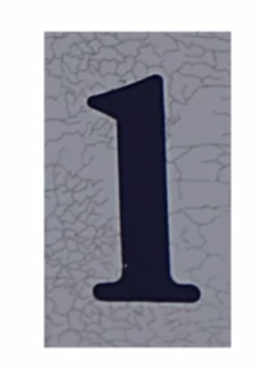
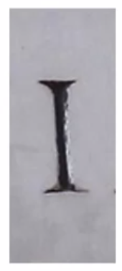
Photo OCR example
Notes:
Example for x to y mapping
Use google street view images to read house numbers
In order to more accurately geo-locate building and houses in Google Maps
One of the task is to take pictures like this and figure out the digit
Sp this is “1”
And this is “I”
You don’t see a lot I’s in street view images, but there are some building where you may see some signs containing I
But house number rarely have an I
You see that your algorithm has a very high accuracy on recognizing 1’s, but low acc on I’s
One thing you might do is add a lot of I examples into your training set

Slide 68

Photo OCR example
Notes:
Example for x to y mapping
Use google street view images to read house numbers
In order to more accurately geo-locate building and houses in Google Maps
One of the task is to take pictures like this and figure out the digit
Sp this is “1”
And this is “I”
You don’t see a lot I’s in street view images, but there are some building where you may see some signs containing I
But house number rarely have an I
You see that your algorithm has a very high accuracy on recognizing 1’s, but low acc on I’s
One thing you might do is add a lot of I examples into your training set
The problem is that there are some images that are truly ambiguous
Is this a 1 or an I
And if you add a lot of I’s into your training set, especially ambiguous examples like this
Then that may skew the dataset to have a lot more I’s, and hurt the performance
Because we know there are a lot more 1’s than I’s on house numbers
If learning algorithm sees a picture like this (last one)
It would be safer to guess that it is a 1 rather than an I
But if data augmentation skews the dataset in the direction of having a lot more I’s
Then it will cause the algorithm to perform poorly on an example like this
This contacts the second point, mapping from x to y is not clear

Slide 69
Can adding data hurt performance?
Yes, if the mapping x to y is not clear
Even humans cannot predict
Notes:
The example we saw is pretty rare and corner case
But understanding this concept can give us more comfort while adding more data

Slide 70
How about structured data?
Notes:
So far we have discussed unstructured data
Turns out creating brand new example is difficult for structured data
But you can take existing training examples and figure out if there are additional useful features you can add to it

Slide 71

How about structured data?
Restaurant recommendation example
Notes:
So far we have discussed unstructured data
Turns out creating brand new example is difficult for structured data
But you can take existing training examples and figure out if there are additional useful features you can add to it
Let’s take an example of restaurant recommendation system
You are running an app that has to recommend restaurants to users that they are interested in
One way is to have a set of features for each user and a set of features for restaurants
That then get fed into a Neural Network
Whose job is to predict whether it is a good prediction or not

Slide 72
How about structured data?
Restaurant recommendation example
Vegetarians are only recommended restaurants with meat options
Notes:
So far we have discussed unstructured data
Turns out creating brand new example is difficult for structured data
But you can take existing training examples and figure out if there are additional useful features you can add to it
Let’s take an example of restaurant recommendation system
You are running an app that has to recommend restaurants to users that they are interested in
One way is to have a set of features for each user and a set of features for restaurants
That then get fed into a Neural Network
Whose job is to predict whether it is a good prediction or not
Error analysis show that the system was unfortunately frequently recommending meat options to vegetarian users, restaurants that only has meat options
Based on the user history, it was pretty clear they are vegetarians
Not a good experience
Now you don’t know how to synthesize new examples of users or new examples of restaurants
Because there is a fixed pool of users and restaurants
Rather than using data aug to create new users and restaurants, it is more fruitful to see if there are features to add either to person input or restaurant input

Slide 73
How about structured data?
Restaurant recommendation example
Vegetarians are only recommended restaurants with meat options
Possible features to add?
Notes:
So far we have discussed unstructured data
Turns out creating brand new example is difficult for structured data
But you can take existing training examples and figure out if there are additional useful features you can add to it
Let’s take an example of restaurant recommendation system
You are running an app that has to recommend restaurants to users that they are interested in
One way is to have a set of features for each user and a set of features for restaurants
That then get fed into a Neural Network
Whose job is to predict whether it is a good prediction or not
Error analysis show that the system was unfortunately frequently recommending meat options to vegetarian users, restaurants that only has meat options
Based on the user history, it was pretty clear they are vegetarians
Not a good experience
Now you don’t know how to synthesize new examples of users or new examples of restaurants
Because there is a fixed pool of users and restaurants
Rather than using data aug to create new users and restaurants, it is more fruitful to see if there are features to add either to person input or restaurant input

Slide 74
How about structured data?
Restaurant recommendation example
Vegetarians are only recommended restaurants with meat options
Possible features to add?
Is person vegetarian? (based on past orders)
Notes:
So far we have discussed unstructured data
Turns out creating brand new example is difficult for structured data
But you can take existing training examples and figure out if there are additional useful features you can add to it
Let’s take an example of restaurant recommendation system
You are running an app that has to recommend restaurants to users that they are interested in
One way is to have a set of features for each user and a set of features for restaurants
That then get fed into a Neural Network
Whose job is to predict whether it is a good prediction or not
Error analysis show that the system was unfortunately frequently recommending meat options to vegetarian users, restaurants that only has meat options
Based on the user history, it was pretty clear they are vegetarians
Not a good experience
Now you don’t know how to synthesize new examples of users or new examples of restaurants
Because there is a fixed pool of users and restaurants
Rather than using data aug to create new users and restaurants, it is more fruitful to see if there are features to add either to person input or restaurant input
Is the person vegeterian
This does not need to be a binary 0 or 1 feature, it can be a soft feature
Some other measure of how likely they seem to be vegeterian

Slide 75
How about structured data?
Restaurant recommendation example
Vegetarians are only recommended restaurants with meat options
Possible features to add?
Is person vegetarian? (based on past orders)
Does restaurant have vegetarian options? (based on the menu)
Notes:
So far we have discussed unstructured data
Turns out creating brand new example is difficult for structured data
But you can take existing training examples and figure out if there are additional useful features you can add to it
Let’s take an example of restaurant recommendation system
You are running an app that has to recommend restaurants to users that they are interested in
One way is to have a set of features for each user and a set of features for restaurants
That then get fed into a Neural Network
Whose job is to predict whether it is a good prediction or not
Error analysis show that the system was unfortunately frequently recommending meat options to vegetarian users, restaurants that only has meat options
Based on the user history, it was pretty clear they are vegetarians
Not a good experience
Now you don’t know how to synthesize new examples of users or new examples of restaurants
Because there is a fixed pool of users and restaurants
Rather than using data aug to create new users and restaurants, it is more fruitful to see if there are features to add either to person input or restaurant input
Is the person vegetarian
This does not need to be a binary 0 or 1 feature, it can be a soft feature
Some other measure of how likely they seem to be vegetarian
Does restaurant have vegetarian options
Based on the menu
For structured data problems
Usually you have a fixed set of user and restaurants
Making it harder to collect new data from users that they don’t yet have on restaurant that may or may not exist
Instead adding features can be a more fruitful way to prove the performance of algorithm
These additional features can be hand-coded or added via another learning algorithm
Such as having a learning algorithm read the menu and classify items as vegetarian or not

Slide 76
Adding features
Recommendation systems
Shift from collaborative filtering to content-based filtering
Notes:
Adding data is not always feasible
Recommendation history etc. can help
Collaborative => what people like you like and then recommends
Content => Looks at you as a separate individual, your history etc.
The advantage of content-based filtering is that
Even if there is a new restaurant or product that hardly anyone else has liked
By actually looking at the description of the restaurant (rather than just looking at who else liked the restaurant)
You can make a good recommendation
This is also called “cold-start” problem => how do you recommend something which no one else has liked or purchased before
One of the ways to do that is to make sure you capture good features of the things that you want to recommend
Designing features especially for small datasets and structured datasets is useful
For unstructured we don’t need to anymore

Slide 77
Data iteration on structured data
Error analysis is harder on structured data problems if there is no good baseline (such as HLP) to compared to
Notes:
Human Level Performance (HLP) is hard for structured data because it is really difficult for people to recommend good restaurants even to each other

Slide 78
Data iteration on structured data
Error analysis, user feedback, benchmarking to competitors can all provides inspiration to add features
Notes:
Through these methods
If you can identify a category or a certain type of tag associated with your data that want to drive your improvement on
Then you can go back and select some features to add such has who is vegetarian and what restaurants have vegetarian options to improve your model
Specific application may only have a finite list of users and restaurants
That is all the data we have
Which is why adding features to the examples you have maybe a more fruitful approach compare to try to come up with new data

Slide 79
Experiment tracking
Notes:
Iterative process
Robust tracking required

Slide 80
Experiment tracking
What to track?
Code and algorithm
Dataset
Hyperparameters
Results (metrics)
Notes:
Iteratively improve your algorithm
Robust tracking required
When you are running dozens of experiments
It is easy to forget what experiment swe already ran
Tracking the experiment can help us to be more efficient in making decision o nthe data, models, hypers etc.
Here are some things we should track

Slide 81
Experiment tracking
Tracking tools
Text files
Spreadsheets
Experiment tracking system
What to track?
Code and algorithm
Dataset
Hyperparameters
Results (metrics)
Notes:
Iterative process
Robust tracking required

Slide 82
Experiment tracking
Tracking tools
Text files
Spreadsheets
Experiment tracking system
What to track?
Code and algorithm
Dataset
Hyperparameters
Results (metrics)
Desirable features
Information needed to replicate results
Experiment results, ideally with summary metrics/analysis
Resource monitoring, visualization, model error analysis
Notes:
Iterative process
Robust tracking required

Slide 83
From BIG data to GOOD data
Ensure high quality data in all phases of ML project lifecycle.
Good data:
Covers important cases
Labels are unambiguous
Has timely feedback from production data
Reasonable size dataset
Notes:
Has timely feedback for production data (distribution covers data and concept drift)
Will talk about them in a while

Slide 84
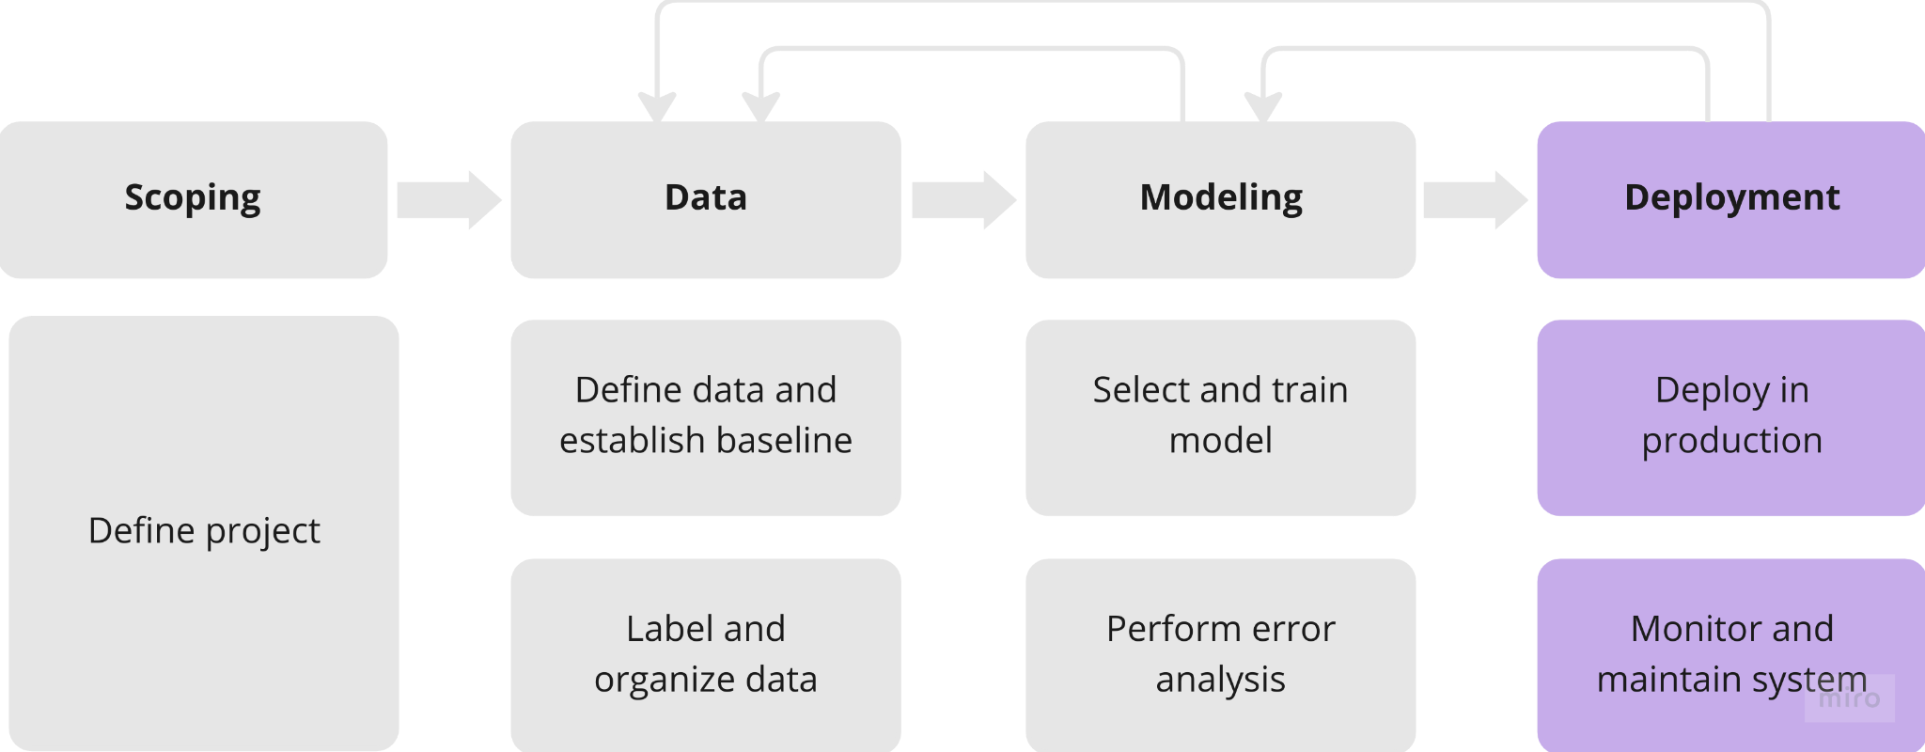
Deployment

Slide 85
Key challenges

Slide 86
Concept drift and Data drift
Has the data changed?
Change can be gradual or sudden
Notes:
Loosely means => what if your data changes after the system has been deployed?
Has the data changed?
Speech recognition
Language can change
People are using newer smartphones
Different microphone => different audio
Gradual change => like english language
Sudden => covid-19 changed pattern of online purchases => many system stopped working
Data drift => someone became famous and is mentioned way more than before
Concept drift
Credit card behavior before covid would show that card is stolen
But after pandemic it does not mean that
Housing prices
Because of changes in market, houses can become expensive
Size hasn’t change but price changes
Data drift would be if people started building larger or smaller houses

Slide 87
Concept drift and Data drift
Has the data changed?
Change can be gradual or sudden
Data drift
Input distribution x changes
Notes:
Loosely means => what if your data changes after the system has been deployed?
Has the data changed?
Speech recognition
Language can change
People are using newer smartphones
Different microphone => different audio
Gradual change => like english language
Sudden => covid-19 changed pattern of online purchases => many system stopped working
Data drift => someone became famous an dis mentioned way more than before
Concept drift
Credit card behavior before covid would show that card is stolen
But after pandemic it does not mean that
Housing prices
Because of changes in market, houses can become expensive
Size hasn’t change but price changes
Data drift would be if people started building larger or smaller houses

Slide 88
Concept drift and Data drift
Has the data changed?
Change can be gradual or sudden
Data drift
Input distribution x changes
Concept drift
Desired mapping from x to y changes
Notes:
Loosely means => what if your data changes after the system has been deployed?
Has the data changed?
Speech recognition
Language can change
People are using newer smartphones
Different microphone => different audio
Gradual change => like english language
Sudden => covid-19 changed pattern of online purchases => many system stopped working
Data drift => someone became famous an dis mentioned way more than before
Concept drift
Credit card behavior before covid would show that card is stolen
But after pandemic it does not mean that
Housing prices
Because of changes in market, houses can become expensive
Size hasn’t change but price changes
Data drift would be if people started building larger or smaller houses

Slide 89
Software engineering issues
Checklist for prediction service
Notes:
For speech recognition, response time is really short so you need realtime
In contrast for hospitals that take health records and run model on them, it is fine to use batch once per night
Compute resources of cloud help in accurate predictions
Edge
System on car run on the edge
Internet can go down in a factory
You train model using a lot of resources but cannot afford same set of resources for deployment
QPS => Queries Per Second
Throughout => how many QPS you need to handle
Maybe useful to log as much data as possible
For analysis and review
Also to provide more data for retraining
Medical records require privacy

Slide 90
Software engineering issues
Checklist for prediction service
Real-time or Batch predictions
Notes:
For speech recognition, response time is really short so you need realtime
In contrast for hospitals that take health records and run model on them, it is fine to use batch once per night
Compute resources of cloud help in accurate predictions
Edge
System on car run on the edge
Internet can go down in a factory
You train model using a lot of resources but cannot afford same set of resources for deployment
QPS => Queries Per Second
Throughout => how many QPS you need to handle
Maybe useful to log as much data as possible
For analysis and review
Also to provide more data for retraining
Medical records require privacy

Slide 91
Software engineering issues
Checklist for prediction service
Real-time or Batch predictions
Cloud or Edge/Browser
Notes:
For speech recognition, response time is really short so you need realtime
In contrast for hospitals that take health records and run model on them, it is fine to use batch once per night
Compute resources of cloud help in accurate predictions
Edge
System on car run on the edge
Internet can go down in a factory
You train model using a lot of resources but cannot afford same set of resources for deployment
QPS => Queries Per Second
Throughout => how many QPS you need to handle
Maybe useful to log as much data as possible
For analysis and review
Also to provide more data for retraining
Medical records require privacy

Slide 92
Software engineering issues
Checklist for prediction service
Real-time or Batch predictions
Cloud or Edge/Browser
Compute resources (GPU/CPU/memory)
Notes:
For speech recognition, response time is really short so you need realtime
In contrast for hospitals that take health records and run model on them, it is fine to use batch once per night
Compute resources of cloud help in accurate predictions
Edge
System on car run on the edge
Internet can go down in a factory
You train model using a lot of resources but cannot afford same set of resources for deployment
QPS => Queries Per Second
Throughout => how many QPS you need to handle
Maybe useful to log as much data as possible
For analysis and review
Also to provide more data for retraining
Medical records require privacy

Slide 93
Software engineering issues
Checklist for prediction service
Real-time or Batch predictions
Cloud or Edge/Browser
Compute resources (GPU/CPU/memory)
Latency, throughput (QPS)
Notes:
For speech recognition, response time is really short so you need realtime
In contrast for hospitals that take health records and run model on them, it is fine to use batch once per night
Compute resources of cloud help in accurate predictions
Edge
System on car run on the edge
Internet can go down in a factory
You train model using a lot of resources but cannot afford same set of resources for deployment
QPS => Queries Per Second
Throughout => how many QPS you need to handle
Maybe useful to log as much data as possible
For analysis and review
Also to provide more data for retraining
Medical records require privacy

Slide 94
Software engineering issues
Checklist for prediction service
Real-time or Batch predictions
Cloud or Edge/Browser
Compute resources (GPU/CPU/memory)
Latency, throughput (QPS)
Logging
Notes:
For speech recognition, response time is really short so you need realtime
In contrast for hospitals that take health records and run model on them, it is fine to use batch once per night
Compute resources of cloud help in accurate predictions
Edge
System on car run on the edge
Internet can go down in a factory
You train model using a lot of resources but cannot afford same set of resources for deployment
QPS => Queries Per Second
Throughout => how many QPS you need to handle
Maybe useful to log as much data as possible
For analysis and review
Also to provide more data for retraining
Medical records require privacy

Slide 95
Software engineering issues
Checklist for prediction service
Real-time or Batch predictions
Cloud or Edge/Browser
Compute resources (GPU/CPU/memory)
Latency, throughput (QPS)
Logging
Security and privacy
Depends on the application
Notes:
For speech recognition, response time is really short so you need realtime
In contrast for hospitals that take health records and run model on them, it is fine to use batch once per night
Compute resources of cloud help in accurate predictions
Edge
System on car run on the edge
Internet can go down in a factory
You train model using a lot of resources but cannot afford same set of resources for deployment
QPS => Queries Per Second
Throughout => how many QPS you need to handle
Maybe useful to log as much data as possible
For analysis and review
Also to provide more data for retraining
Medical records require privacy

Slide 96
Deployment patterns
Common deployment cases
New product/capability
Automate/assist a manual task
Replace previous ML system
Notes:
New product/capability
Start with small amount of traffic and gradually ramp it up
Assist
People inspected smartphones
You want to automate or assist
Key ideas:
Gradually ramp up with monitoring
Rollback
If algorithm is not working, revert to previous system

Slide 97
Shadow mode deployment
ML system shadows a human inspector or an older system
Allows you to gather data
How model is performing w.r.t previous system or human
Notes:
Visual inspection
ML system shadows the humans and runs in parallel
ML system’s output is not used for any decisions during this phase
Then based on the results, you can decide whether to allow mL system to make real-world decisions or not

Slide 98
Canary deployment
Roll out to small fraction (say 5%) of the overall traffic initially.
Monitor system and ramp up traffic gradually.
Notes:
When you are ready to allow ML system to make decisions
Allows you to spot problems early on and avoid larger consequences

Slide 99
Blue green deployment
Old/Blue version
Router
Data
Old/Blue version
Notes:
You have an old prediction service
Then you spin up a new prediction service
You suddenly have the router switch the traffic from old one to the new one

Slide 100
Blue green deployment
Old/Blue version
Router
Data
Old/Blue version
Notes:
You have an old prediction service
Then you spin up a new prediction service
You suddenly have the router switch the traffic from old one to the new one

Slide 101
Blue green deployment
Easy way to enable rollback
Old/Blue version
Router
Data
Old/Blue version
Notes:
You can switch traffic 100% at the same time
But you can use a more gradual version
A lot of tools required for all these modes
MLOps tools can help with implementing these deployment patterns

Slide 102
Degrees of automation
What is appropriate degree of automation
Notes:
One of the useful framework is to not think about deployment as 0 or 1 i.e. deployed or not deployed
Visual inspection degrees
No automation => human only
Shadow mode
AI assistance
Model gives some idea to inspector where the defect is
Partial automation
Human only predicts when model is not sure about prediction if it is 0 or 1 => confidence value
Full automation
You can stop before getting to full automation
Quite often best design is to have a human in the looop

Slide 103
Monitoring
Monitoring dashboard
Server load
Missing input values
Fraction of non-null outputs
What to monitor?
Brainstorm the things that could go wrong
Brainstorm few metrics that will detect the problem
Notes:
More on it at the end when I talk about ClearML
It is ok to use many metrics initially and gradually remove the ones you don’t find useful

Slide 104
Examples of metrics to track
Software metrics | Memory, compute, latency, throughput, server load
Notes:
Software metrics
Many MLOps tools will support these software metrics out of the box
Inputs metrics
Has your input distribution x changed
Output metrics
User redoes search => misunderstood query first time
User switches to typing => user gave up on our speech system

Slide 105
Examples of metrics to track
Software metrics | Memory, compute, latency, throughput, server load
Input metrics
Average input length/volume
Number of missing values (structured data)
Average image brightness (vision)
Notes:
Software metrics
Many MLOps tools will support these software metrics out of the box
Inputs metrics
Has your input distribution x changed
Output metrics
User redoes search => misunderstood query first time
User switches to typing => user gave up on our speech system

Slide 106
Examples of metrics to track
Software metrics | Memory, compute, latency, throughput, server load
Input metrics
Average input length/volume
Number of missing values (structured data)
Average image brightness (vision)
Output metrics
# you get null (speech)
# times user redoes search
# times user switches to typing
Notes:
Software metrics
Many MLOps tools will support these software metrics out of the box
Inputs metrics
Has your input distribution x changed
Output metrics
User redoes search => misunderstood query first time
User switches to typing => user gave up on our speech system

Slide 107
Deployment is also iterative
Deployment/
Monitoring
Performance analysis
Traffic
Notes:
Usually takes a few tries to converge to right set of metrics to monitor

Slide 108
Monitoring dashboard
Set thresholds for alarms
Adapt metrics and threshold over time
Notes:
If server load goes above threshold => raise alarm => check problem or spin up new service

Slide 109

Model maintenance
Manual retraining
Automatic retraining
Notes:
If the model needs to be updated
Retrain manually
Today manual retraining is far more common
Developers are reluctant to let model decide when to retrain
Only by monitoring the system, you can spot problems
Go back and perform deeper error analysis
Get more data and update the model

Slide 110
Pipeline monitoring
ML pipelines and be complex
Metrics to monitor
Software, input and output metrics
Can help spot problems
How quickly change occurs
User data has generally slow drift (there are exceptions)
Enterprise (B2B) applications, data can shift quickly
Notes:
Multiple step pipelines
VAD => voice activity detectory
Speech recognition VAD example
VAD decides when to pass data to speech model
If VAD changes data (different cellphone) => it can affect model’s performance
How quickly does data change?
Problem dependent
Enterpeise => phon company decides to use new coating for phone => data changes suddenly

Slide 111
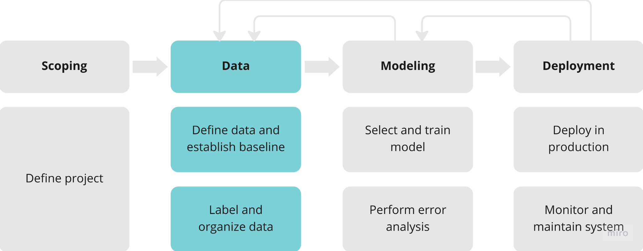
Data

Slide 112
Data definition and baseline

Slide 113
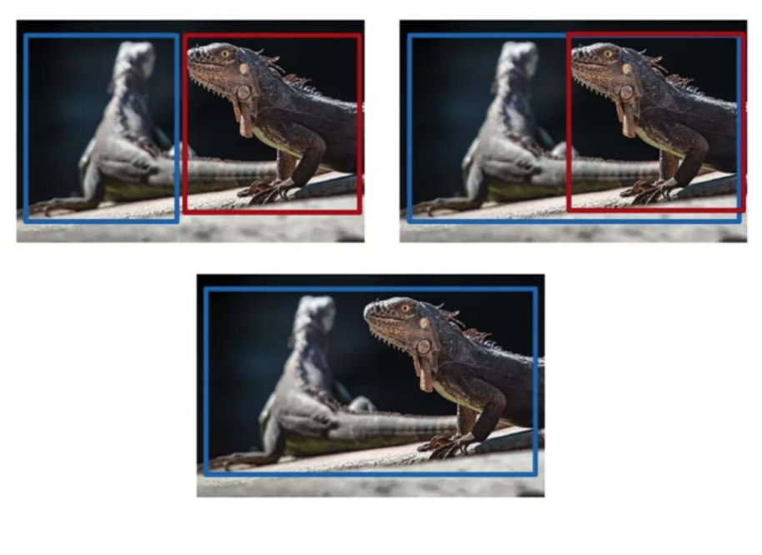
Why is data definition hard?
Label ambiguity
Notes:
Three hardworking labelers can label data differently

Slide 114
Why is data definition hard?
Label ambiguity
“Um, nearest cafe.”
“Umm, nearest cafe.”
“Um...nearest cafe.”
Notes:
Three hardworking labelers can label data differently

Slide 115
Data definition questions
What is the input x?
Lighting good enough? Contrast? Resolution?
What features need to be included (structured data)
What is the target y?
How can we ensure labelers give consistent labels
Notes:
If the input image is too dark, right thing to do is maybe to go to the factory and ask them to improve the lightning

Slide 116
Major types of data problems
 | Unstructured | Structured | Focus
Small data (<=10,000) | Manufacturing visual inspection from 100 training examples | House price prediction based on 50 training examples | Clean labels critical
Big data (>10,000) | Speech recognition from 50 million training examples | Online shopping recommendations for 1 million users | Emphasis on data process
Notes:
Best practices for organizing data for one type of data can be very different from another type of data (structured vs. unstructured)
Big data => hard to examine each example yourself
For lot of unstructured data problems
People can help label data
Data aug can help
For structure data
Harder to obtain more data
Hard to synthesize new users or houses that do not exist
Also harder to perform data aug
Human labeling might not be possible
Humans are trained to deal with unstructured data
For small dataset, having clean labels are critical
Out of 100, 5 mislabeled => 5% => huge
You can manually check each image and fix
For large data
Emphasis on data processes
How to you collect and store
Labeling instructions
Having clean labels is still important
Advice from someone who has worked in same quadrant is more useful than someone who worked in a different quadrant
Same goes for hiring

Slide 117
Small data vs. big data
Small data

Slide 118
Small data vs. big data
Small data
Clean labels are critical
Can manually look through dataset and fix labels
Can get all labelers to talk to each other

Slide 119
Small data vs. big data
Small data
Clean labels are critical
Can manually look through dataset and fix labels
Can get all labelers to talk to each other
Big data
Emphasis data process
Consistent label definition
Clear labeling instructions

Slide 120
Small data and label consistency
Easy to fit function
Get inspectors/labels to agree
Categories
Labeling instructions
Big data can have small data challenges too
Notes:
Small data but if labels are clean and consistent => model can work well
Big data can also have small data issues
Web data is large but some queries are rare
Self-driving cars
There are rare occurrences => a young child running across highway => rare events
Ensuring label consistency in terms of how these rare events are detected is still helpful
Product recommendation system
A lot of products => number of sold is small

Slide 121
Improving label consistency
Have multiple labelers label same example
Resolve disagreements
If labelers think input does not contain enough informations
Consider changing the input
Iterate until it is significantly hard to increase agreement
Notes:
Sometimes even ask the same labeler to relabel after few days

Slide 122
Improving label consistency
Standardize labels
“Um, nearest cafe”
“Umm, nearest cafe”
“Um.. nearest cafe”
Notes:
Sometimes even ask the same labeler to relabel after few days

Slide 123
Improving label consistency
Standardize labels
“Um, nearest cafe”
“Umm, nearest cafe” “Um, nearest cafe”
“Um.. nearest cafe”
Notes:
Sometimes even ask the same labeler to relabel after few days

Slide 124
Improving label consistency
Standardize labels
“Um, nearest cafe”
“Umm, nearest cafe” “Um, nearest cafe”
“Um.. nearest cafe”
Merge classes
Deep scratch, shallow scratch => scratch
Notes:
Sometimes even ask the same labeler to relabel after few days

Slide 125
Improving label consistency
Have a class/label to capture uncertainty
Visual inspection
Defect: 0
No defect: 1
Borderline: 2
Audio
“Nearest go”
“Nearest grocery” “Nearest [unintelligible]”

Slide 126
Small data vs. big data (unstructured data)
Small data
Can ask labelers to sit down and discuss specific labels
Big data
Consistent labeling definitions wit small groups
The send labeling instructions to a larger group
Voting or consensus labels
Notes:
One technique that is commonly used is have multiple labelers labe levery example and then perform voting to increase accuracy
Many teams have inconsistent labeling instructions, and then they use this method to resolve them
Better would be to have proper guidelines

Slide 127
Human level performance (HLP)
Why measure HLP?
Estimate bayes error (irreducible error)
What might be possible
Some demands might not be feasible
Compare human with ground-truth
Notes:
HLP is a good baselines but it is often misused
Instead of jumping into the project, first check how a human performs and what is feasible
Don’t expect model to beat HLP
Vision inspection,
Ask an inspector to labe land compare with ground truth

Slide 128
Questions that we forget to ask
What exactly is the ground-truth?
Notes:
Is ground-truth also established by another human?
Are we really measuring what is possible or are we measuring if two different people agree with each other or not?
If ground-truth is also established by a human, then we have a very different approach

Slide 129
Other uses of HLP
In academia, establish and beat a respectable benchmark
Business owner asks for 99% accuracy
HLP helps establish a more reasonable target
“Prove” that ML system is superior to humans
Notes:
Academia
Showing you can beat HLP is the standard to show significance of your work
Helps with publications
Prove that ML system is superior and thus business owner should adopt it
The logic is very tempting
But ads a practical matter, this approach rarely works
Use this logic with caution
Don’t use it
Business need more than just doing well on average test set accuracy

Slide 130
The problem with beating HLP as a proof of ML superiority
Example
“Um..nearest cafe” => 70% labelers
“Um, nearest cafe” => 30% labelers
Notes:
Now you would think that HLP is 0.58
But what you are really measuring is the chance of two random labelers agreeing
This give ML algorithm an unfair advantage
If learning algorithm gathers statistics
Maybe always use “Um…” convention because it has a 70% chance of getting it right
By choosing first convention, it will agree with humans 70% of the time
It seems like a 12% advantage
But it is not actually outperforming any human in any way that a user would care about
If learning algorithm makes other significant error on some other type of audio
Then that worse performance could be averages out by cases like above (fake better performance cases) => mask/hide actual performance
Looks like performing better than HLP, but actually producing worse transcripts than people
Thesis example
Issues with past approaches
Bias, no test set, data leakage, metrics, different data
Good research
Still didn’t publish in the end because I did not know who is it that I defeated, also lost interest in publishing papers
Are my results beating HLP?
Are they beating just old approaches?
Can we actually use it in practice?

Slide 131
The problem with beating HLP as a proof of ML superiority
Example
“Um..nearest cafe” => 70% labelers
“Um, nearest cafe” => 30% labelers
Two random labelers agree: (0.7^2) + (0.3^2) = 0.58
Notes:
Now you would think that HLP is 0.58
But what you are really measuring is the chance of two random labelers agreeing
This give ML algorithm an unfair advantage
If learning algorithm gathers statistics
Maybe always use “Um…” convention because it has a 70% chance of getting it right
By choosing first convention, it will agree with humans 70% of the time
It seems like a 12% advantage
But it is not actually outperforming any human in any way that a user would care about
If learning algorithm makes other significant error on some other type of audio
Then that worse performance could be averages out by cases like above (fake better performance cases) => mask/hide actual performance
Looks like performing better than HLP, but actually producing worse transcripts than people
Thesis example
Issues with past approaches
Bias, no test set, data leakage, metrics, different data
Good research
Still didn’t publish in the end because I did not know who is it that I defeated, also lost interest in publishing papers
Are my results beating HLP?
Are they beating just old approaches?
Can we actually use it in practice?

Slide 132
The problem with beating HLP as a proof of ML superiority
Example
“Um..nearest cafe” => 70% labelers
“Um, nearest cafe” => 30% labelers
Two random labelers agree: (0.7^2) + (0.3^2) = 0.58
ML agrees with humans: 0.7
Notes:
Now you would think that HLP is 0.58
But what you are really measuring is the chance of two random labelers agreeing
This give ML algorithm an unfair advantage
If learning algorithm gathers statistics
Maybe always use “Um…” convention because it has a 70% chance of getting it right
By choosing first convention, it will agree with humans 70% of the time
It seems like a 12% advantage
But it is not actually outperforming any human in any way that a user would care about
If learning algorithm makes other significant error on some other type of audio
Then that worse performance could be averages out by cases like above (fake better performance cases) => mask/hide actual performance
Looks like performing better than HLP, but actually producing worse transcripts than people
Thesis example
Issues with past approaches
Bias, no test set, data leakage, metrics, different data
Good research
Still didn’t publish in the end because I did not know who is it that I defeated, also lost interest in publishing papers
Are my results beating HLP?
Are they beating just old approaches?
Can we actually use it in practice?

Slide 133
The problem with beating HLP as a proof of ML superiority
Example
“Um..nearest cafe” => 70% labelers
“Um, nearest cafe” => 30% labelers
Two random labelers agree: (0.7^2) + (0.3^2) = 0.58
ML agrees with humans: 0.7
This 12% performance is not important for anything!
Notes:
Now you would think that HLP is 0.58
But what you are really measuring is the chance of two random labelers agreeing
This give ML algorithm an unfair advantage
If learning algorithm gathers statistics
Maybe always use “Um…” convention because it has a 70% chance of getting it right
By choosing first convention, it will agree with humans 70% of the time
It seems like a 12% advantage
But it is not actually outperforming any human in any way that a user would care about
If learning algorithm makes other significant error on some other type of audio
Then that worse performance could be averages out by cases like above (fake better performance cases) => mask/hide actual performance
Looks like performing better than HLP, but actually producing worse transcripts than people
Thesis example
Issues with past approaches
Bias, no test set, data leakage, metrics, different data
Good research
Still didn’t publish in the end because I did not know who is it that I defeated, also lost interest in publishing papers
Are my results beating HLP?
Are they beating just old approaches?
Can we actually use it in practice?

Slide 134
The problem with beating HLP as a proof of ML superiority
Example
“Um..nearest cafe” => 70% labelers
“Um, nearest cafe” => 30% labelers
Two random labelers agree: (0.7^2) + (0.3^2) = 0.58
ML agrees with humans: 0.7
This 12% performance is not important for anything!
Side effect => This can mask more significant error ML might be making
Notes:
Now you would think that HLP is 0.58
But what you are really measuring is the chance of two random labelers agreeing
This give ML algorithm an unfair advantage
If learning algorithm gathers statistics
Maybe always use “Um…” convention because it has a 70% chance of getting it right
By choosing first convention, it will agree with humans 70% of the time
It seems like a 12% advantage
But it is not actually outperforming any human in any way that a user would care about
If learning algorithm makes other significant error on some other type of audio
Then that worse performance could be averages out by cases like above (fake better performance cases) => mask/hide actual performance
Looks like performing better than HLP, but actually producing worse transcripts than people
Thesis example
Issues with past approaches
Bias, no test set, data leakage, metrics, different data
Good research
Still didn’t publish in the end because I did not know who is it that I defeated, also lost interest in publishing papers
Are my results beating HLP?
Are they beating just old approaches?
Is this comparison even fair? Different data and metrics
Can we actually use it in practice?

Slide 135
Raising HLP
Well defined ground-truth
When the ground-truth is externally defined
HLP gives estimate for Bayes error
Often ground-truth is label from another human
Notes:
If goal is to build a useful application, not publish a paper
It is useful to raise HLP
It helped people get papers published
Misused
Nothing valuable comes out
When the ground-truth is really well defined, then there are fewer problems with HLP
Medical Imaging
If the ground-truth is defined by a biopsy or medical test (externally defined)
then HLP helps you measure how well does a doctor vs. a learning algorithm predict the outcome
Really useful
But if ground-truth is defined by a human (maybe even a doctor)
HLP is measuring how well a doctor predicts another doctor’s labels vs. how well ML can predict another doctor’s labels
It is useful but different

Slide 136
Raising HLP
Scratch length (mm) | Ground Truth Label | Inspector
0.7 | 1 | 1
0.2 | 1 | 0
0.5 | 1 | 1
0.2 | 0 | 0
0.1 | 0 | 0
0.1 | 0 | 1
HLP: 66.7%
Notes:
Rather than beating human inspector
It might be useful to check why groundtruth labeler and inspector don’t agree
0.3mm threshold

Slide 137
Raising HLP
Scratch length (mm) | Ground Truth Label | Inspector
0.7 | 1 | 1
0.2 | 0 | 0
0.5 | 1 | 1
0.2 | 0 | 0
0.1 | 0 | 0
0.1 | 0 | 0
HLP: 100%
Notes:
Rather than beating human inspector
It might be useful to check why groundtruth labeler and inspector don’t agree
0.3mm threshold
Now we have raised HLP to 100% by getting two humans to agree
Impossible to beat
You cannot tell business owner that you beat HLP anymore
But the benefit is more consistent data
Ultimately improves learning algorithm

Slide 138
Raising HLP
When the labeling comes from humans
HLP << 100% => ambiguous labeling instructions
Improving labeling consistency will increase HLP
This makes it harder to beat HLP (too bad, no paper)
However it raises performance of ML system
Ultimately likely to benefit the actual application performance

Slide 139
HLP on structured data
Less likely to involves humans labelers
HLP less used
Some exceptions where you might ask humans:
User ID merging: Same person?
Based on network traffic, is the computer hacked?
Is this transaction fraudulent
Spam or Bot account?
From GPS, what is the mode of transportation?
Notes:
Ask human to label data for the first pass if possible

Slide 140
Label and organize data

Slide 141
How long should you spend obtaining data?
Get into this iteration loop as quickly as possible
How much data can we obtain in n days?
Add/improve data
(hold model fixed
Error analysis
Training
Notes:
You have defined definition of data, but how do you actually obtain data for your task? Let’s see some best practices.
If training and error analysis take 2 days, don’t spend 30 days collecting data. Maybe spend 2-4 days. Many teams take far too long.
Instead of asking “how long it would take to obtain n examples?” ask “How much data can we obtain in n days”.
Exception
Is you already worked on the problem before and you know that you need n examples
Error analysis will tell you if it is worth to go out and collect more data

Slide 142
Inventory data
Brainstorm list of data sources
Source | Amount | Cost | Time
Owned | 100h | $0 | 0 days
Crowdsourcing (Reading) | 1000h | $10000 | 14 days
Pay for labels | 100h | $6000 | 7 days
Purchase data | 1000h | $10000 | 1 day
Notes:
Speech recognition example
Data quality
Paying for labels might give better quality than crowdsourcing people’s readings

Slide 143
Inventory data
Brainstorm list of data sources
Owned
Crowdsourcing
Pay for labels
Purchase data
Source | Amount | Cost | Time
Owned | 100h | $0 | 0 days
Crowdsourcing (Reading) | 1000h | $10000 | 14 days
Pay for labels | 100h | $6000 | 7 days
Purchase data | 1000h | $10000 | 1 day
Notes:
Speech recognition example
Data quality
Paying for labels might give better quality than crowdsourcing people’s readings

Slide 144
Inventory data
Brainstorm list of data sources
Owned
Crowdsourcing
Pay for labels
Purchase data
Other factors
Data quality
Privacy
Regulatory constraints
Source | Amount | Cost | Time
Owned | 100h | $0 | 0 days
Crowdsourcing (Reading) | 1000h | $10000 | 14 days
Pay for labels | 100h | $6000 | 7 days
Purchase data | 1000h | $10000 | 1 day
Notes:
Speech recognition example
Data quality
Paying for labels might give better quality than crowdsourcing people’s readings

Slide 145
Labeling data
Options | In-house vs. outsourced vs. crowdsourced
Notes:
If you decide to get data labeled, here are some of the options
Outsourcing -> another company or group -> specialized companies
Having ML experts label the data is expensive
Might be fine for few days
To get a project going quickly
Helps build intuition about data
But as ML engineer, you don’t want to spend all the time on labeling data beyond a certain time.
Recommender systems
You have to rely on purchased data by the person
Rather than having humans label data
Let’s say you have 1000 examples, and you need a bigger dataset. How much bigger should you make your dataset?
One tip -> Don’t increase data by more than 10x at a time
5x to 10x first
Carry out error analysis and then figure out

Slide 146
Labeling data
Options | In-house vs. outsourced vs. crowdsourced
Having ML Experts label data is expensive
Notes:
If you decide to get data labeled, here are some of the options
Outsourcing -> another company or group -> specialized companies
Having ML experts label the data is expensive
Might be fine for few days
To get a project going quickly
Helps build intuition about data
But as ML engineer, you don’t want to spend all the time on labeling data beyond a certain time.
Recommender systems
You have to rely on purchased data by the person
Rather than having humans label data
Let’s say you have 1000 examples, and you need a bigger dataset. How much bigger should you make your dataset?
One tip -> Don’t increase data by more than 10x at a time
5x to 10x first
Carry out error analysis and then figure out

Slide 147
Labeling data
Options | In-house vs. outsourced vs. crowdsourced
Having ML Experts label data is expensive
Who is qualified to label?
Notes:
If you decide to get data labeled, here are some of the options
Outsourcing -> another company or group -> specialized companies
Having ML experts label the data is expensive
Might be fine for few days
To get a project going quickly
Helps build intuition about data
But as ML engineer, you don’t want to spend all the time on labeling data beyond a certain time.
Recommender systems
You have to rely on purchased data by the person
Rather than having humans label data
Let’s say you have 1000 examples, and you need a bigger dataset. How much bigger should you make your dataset?
One tip -> Don’t increase data by more than 10x at a time
5x to 10x first
Carry out error analysis and then figure out

Slide 148
Labeling data
Options | In-house vs. outsourced vs. crowdsourced
Having ML Experts label data is expensive
Who is qualified to label?
Speech recognition - any fluent speaker
Medical diagnosis - Subject Matter Expert (SME)
Recommender systems - maybe impossible to label well
Notes:
If you decide to get data labeled, here are some of the options
Outsourcing -> another company or group -> specialized companies
Having ML experts label the data is expensive
Might be fine for few days
To get a project going quickly
Helps build intuition about data
But as ML engineer, you don’t want to spend all the time on labeling data beyond a certain time.
Recommender systems
You have to rely on purchased data by the person
Rather than having humans label data
Let’s say you have 1000 examples, and you need a bigger dataset. How much bigger should you make your dataset?
One tip -> Don’t increase data by more than 10x at a time
5x to 10x first
Carry out error analysis and then figure out

Slide 149
Labeling data
Options | In-house vs. outsourced vs. crowdsourced
Having ML Experts label data is expensive
Who is qualified to label?
Speech recognition - any fluent speaker
Medical diagnosis - Subject Matter Expert (SME)
Recommender systems - maybe impossible to label well
Don’t increase data by more than 10x at a time
Notes:
If you decide to get data labeled, here are some of the options
Outsourcing -> another company or group -> specialized companies
Having ML experts label the data is expensive
Might be fine for few days
To get a project going quickly
Helps build intuition about data
But as ML engineer, you don’t want to spend all the time on labeling data beyond a certain time.
Recommender systems
You have to rely on purchased data by the person
Rather than having humans label data
Let’s say you have 1000 examples, and you need a bigger dataset. How much bigger should you make your dataset?
One tip -> Don’t increase data by more than 10x at a time
5x to 10x first
Carry out error analysis and then figure out

Slide 150
Data pipeline/cascades
Data
Preprocessing
scripts
Test set
performance
Development
ML system
Production
Data
Replicated
scripts
Product
How to replicate scripts?
Notes:
Data pipelines -> when data has multiple steps of processing before going into the model
There are some best practices
If your Data Cleaning is with another model, pipeline becomes more complicated
If Preprocessing steps were done on bunch of computers by different people, how do you replicate this so that the input distribution is same

Slide 151
POC and Production phases
POC phase
Notes:
In production phase, use more sophisticated tools to ensure that data pipeline is replicable

Slide 152
POC and Production phases
POC phase
Goal is to decide if the application is workable and worth deploying
Focus on getting the prototype to work
It’s ok if data processing is manual
Take extensive notes/comments
Notes:
In production phase, use more sophisticated tools to ensure that data pipeline is replicable

Slide 153
POC and Production phases
POC phase
Goal is to decide if the application is workable and worth deploying
Focus on getting the prototype to work
It’s ok if data processing is manual
Take extensive notes/comments
Production phase
Use more sophisticated tools
Apache Beam, Airflow, Prefect, etc.
Notes:
In production phase, use more sophisticated tools to ensure that data pipeline is replicable

Slide 154
Data provenance and lineage
Notes:
Having built up a complex system
E.g. Job search model
Spam dataset -> antispam model -> despammed data + id merge data -> id merge model -> clean user data -> Job search model -> Predictions
If you were to update your spam dataset
It will change everything
How do you go back and fix this problem?
Especially each of the system is developed by a different engineer and you have files spread across laptops of your ML dev team
To make sure system is maintainable
Extensive documentation can help
Sophisticated tools on production phase

Slide 155
Data provenance and lineage
Data provenance | Where the data came from
Data lineage | Sequence of steps applied to the data
Notes:
Having built up a complex system
E.g. Job search model
Spam dataset -> antispam model -> despammed data + id merge data -> id merge model -> clean user data -> Job search model -> Predictions
If you were to update your spam dataset
It will change everything
How do you go back and fix this problem?
Especially each of the system is developed by a different engineer and you have files spread across laptops of your ML dev team
To make sure system is maintainable
Extensive documentation can help
Sophisticated tools on production phase

Slide 156
Meta-data
Examples
Notes:
Data about data
Can turn out to be really useful
If you discover during ML development that for some strange reason, line # 17 in factory # 2 generates images that produce images with lot more errors for some reason
This allows you to go back and see what was the issue with that line
If you had not stored this meta-data, it would be really difficult
It is like code comments

Slide 157

Meta-data
Examples
Factory inspection: time, factory, line #, camera settings, phone model, etc.
Notes:
Data about data
Can turn out to be really useful
If you discover during ML development that for some strange reason, line # 17 in factory # 2 generates images that produce images with lot more errors for some reason
This allows you to go back and see what was the issue with that line
If you had not stored this meta-data, it would be really difficult
It is like code comments

Slide 158

Meta-data
Examples
Factory inspection: time, factory, line #, camera settings, phone model, etc.
Speech recognition: device type, labeler ID, VAD model, etc.
Notes:
Data about data
Can turn out to be really useful
If you discover during ML development that for some strange reason, line # 17 in factory # 2 generates images that produce images with lot more errors for some reason
This allows you to go back and see what was the issue with that line
If you had not stored this meta-data, it would be really difficult
It is like code comments

Slide 159
Balanced splits
Visual inspection: 100 examples, 30 positive (defective)
Notes:
Many of us split data into train/dev/test randomly.
If your dataset is small
Having balanced split can significantly boost your performance
This makes dev set quite non-representative
We have only 2 (10%) positive examples rather than 30% as in original data
If we have a very large dataset, the no need to worry about this
A random split will be representative enough
This can make a big difference in small data

Slide 160
Balanced splits
Visual inspection: 100 examples, 30 positive (defective)
Train/dev/test: 60%/20%/20%
Notes:
Many of us split data into train/dev/test randomly.
If your dataset is small
Having balanced split can significantly boost your performance
This makes dev set quite non-representative
We have only 2 (10%) positive examples rather than 30% as in original data
If we have a very large dataset, the no need to worry about this
A random split will be representative enough
This can make a big difference in small data

Slide 161
Balanced splits
Visual inspection: 100 examples, 30 positive (defective)
Train/dev/test: 60%/20%/20%
Random split: 21 (35%) / 2 (10%)/ 7 (35%) positive examples
Notes:
Many of us split data into train/dev/test randomly.
If your dataset is small
Having balanced split can significantly boost your performance
This makes dev set quite non-representative
We have only 2 (10%) positive examples rather than 30% as in original data
If we have a very large dataset, the no need to worry about this
A random split will be representative enough
This can make a big difference in small data

Slide 162
Balanced splits
Visual inspection: 100 examples, 30 positive (defective)
Train/dev/test: 60%/20%/20%
Random split: 21 (35%) / 2 (10%)/ 7 (35%) positive examples
Want: 18 (30%)/6 (30%)/6 (30%) balanced split
Notes:
Many of us split data into train/dev/test randomly.
If your dataset is small
Having balanced split can significantly boost your performance
This makes dev set quite non-representative
We have only 2 (10%) positive examples rather than 30% as in original data
If we have a very large dataset, the no need to worry about this
A random split will be representative enough
This can make a big difference in small data

Slide 163
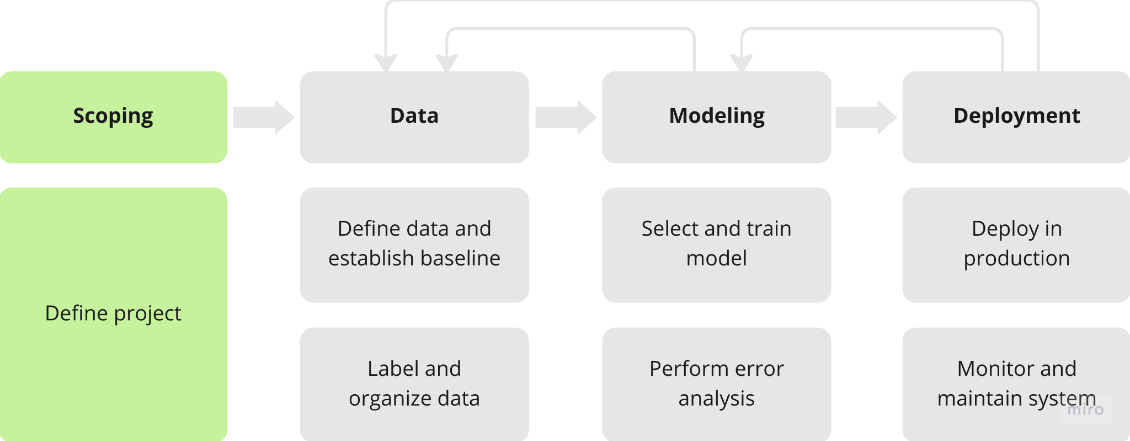
Scoping

Slide 164

What is scoping?
Example
Ecommerce retailer looking to increase sales
Notes:
If you are going to spend months on an project, it is work a while to think through the options and select the most promising project to work on before putting so much effort into it
With a quick brainstorming session, you might come up with a dozen of ideas
Some ideas are going to be way more valuable than others

Slide 165
What is scoping?
Example
Ecommerce retailer looking to increase sales
Better recommender system
Better search
Improve catalog data
Inventory management
Price optimization
Notes:
If you are going to spend months on an project, it is work a while to think through the options and select the most promising project to work on before putting so much effort into it
With a quick brainstorming session, you might come up with a dozen of ideas
Some ideas are going to be way more valuable than others

Slide 166
What is scoping?
Example
Ecommerce retailer looking to increase sales
Better recommender system
Better search
Improve catalog data
Inventory management
Price optimization
Questions:
What project should we work on?
What are the metrics for success?
What are the resources (data, time people) needed?
Notes:
If you are going to spend months on an project, it is work a while to think through the options and select the most promising project to work on before putting so much effort into it
With a quick brainstorming session, you might come up with a dozen of ideas
Some ideas are going to be way more valuable than others

Slide 167
Scoping process
Brainstorm business problems
Notes:
Get together with business owner (not AI expert)
What are their business problems
Increase conversion -> number of people that go to website and convert them to sales
Not trying to figure out AI problem yet, just business problems
Then I will try to see if there is an AI solution for you
This type of separation between problem and solution can help come up with a better solution

Slide 168
Scoping process
Brainstorm business problems
What are the top 3 things you wish were working better?
Increase conversion
Reduce inventory
Increase margin (profit per item)
Notes:
Get together with business owner (not AI expert)
What are their business problems
Increase conversion -> number of people that go to website and convert them to sales
Not trying to figure out AI problem yet, just business problems
Then I will try to see if there is an AI solution for you
This type of separation between problem and solution can help come up with a better solution

Slide 169
Scoping process
Brainstorm business problems
Brainstorm AI solutions
What are the top 3 things you wish were working better?
Increase conversion
Reduce inventory
Increase margin (profit per item)
Notes:
Get together with business owner (not AI expert)
What are their business problems
Increase conversion -> number of people that go to website and convert them to sales
Not trying to figure out AI problem yet, just business problems
Then I will try to see if there is an AI solution for you
This type of separation between problem and solution can help come up with a better solution

Slide 170
Scoping process
Brainstorm business problems
Brainstorm AI solutions
Assess the feasibility and value of potential solutions
What are the top 3 things you wish were working better?
Increase conversion
Reduce inventory
Increase margin (profit per item)
Notes:
Get together with business owner (not AI expert)
What are their business problems
Increase conversion -> number of people that go to website and convert them to sales
Not trying to figure out AI problem yet, just business problems
Then I will try to see if there is an AI solution for you
This type of separation between problem and solution can help come up with a better solution

Slide 171
Scoping process
Brainstorm business problems
Brainstorm AI solutions
Assess the feasibility and value of potential solutions
Determine milestones
What are the top 3 things you wish were working better?
Increase conversion
Reduce inventory
Increase margin (profit per item)
Notes:
Get together with business owner (not AI expert)
What are their business problems
Increase conversion -> number of people that go to website and convert them to sales
Not trying to figure out AI problem yet, just business problems
Then I will try to see if there is an AI solution for you
This type of separation between problem and solution can help come up with a better solution

Slide 172
Scoping process
Brainstorm business problems
Brainstorm AI solutions
Assess the feasibility and value of potential solutions
Determine milestones
Budget for resources
What are the top 3 things you wish were working better?
Increase conversion
Reduce inventory
Increase margin (profit per item)
Notes:
Get together with business owner (not AI expert)
What are their business problems
Increase conversion -> number of people that go to website and convert them to sales
Not trying to figure out AI problem yet, just business problems
Then I will try to see if there is an AI solution for you
This type of separation between problem and solution can help come up with a better solution

Slide 173
Separating problem identification from solution
Problem | Solution
Increase conversion | Search, recommendations
Reduce inventory | Demand prediction, marketing
Increase margin | Optimizing what to sell, recommend bundles
Notes:
Increase conversion => improve search results, offer better recommendations
It is quite common that one problem may lead to multiple ideas for solution
Recommend bundles => if someone buys a camera, you also recommend them protectors and lenses
Many teams just jump into the first project that they are excited about
Brainstorm the possibilities and then narrow down to most promising projects

Slide 174
Feasibility
Use external benchmarks (literature, other companies, etc.)
 | Unstructured (speech, images) | Structured (transaction records)
New | HLP | Are predictive features available?
Existing | HLP History of project | New predictive features History of project
Notes:
Is this project technically feasible
HLP => Can human, given the same data, perform the task?
Do you think that the data and features x you have are sufficiently predictive or the target output y?

Slide 175
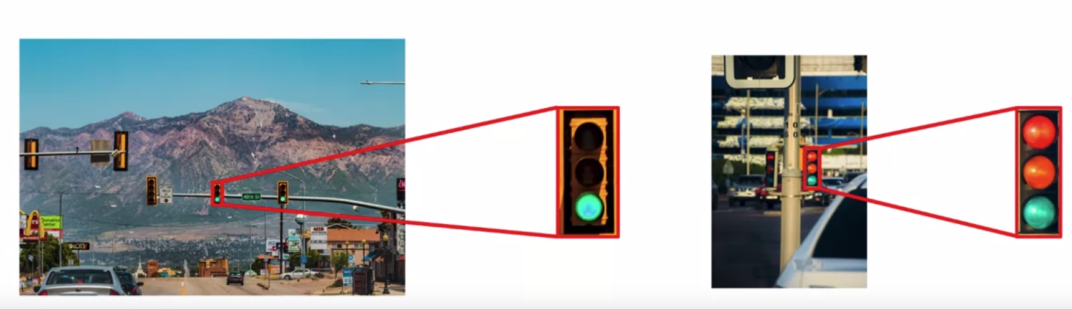
Why use HLP to benchmark?
People are very good on unstructured data tasks.
Notes:
Right one => even human cannot
Make sure humans see exactly same data as the model
This does not mean to ask a person who is driving a car and sees the traffic light
We should take same picture and ask human to classify
Teams keep working on CV system for a long time, and they thought they can do it because a human who physically inspected the phones could do it
Took long time to realize that if same human saw the images, he couldn’t figure it out either

Slide 176

Do we have features that are predictive
Given past purchases, predict future purchases
Notes:
The mapping from DNA to whether you get a heart disease is very noisy

Slide 177

Do we have features that are predictive
Given past purchases, predict future purchases
Notes:
The mapping from DNA to whether you get a heart disease is very noisy

Slide 178

Do we have features that are predictive
Given past purchases, predict future purchases
Given weather, predict shopping mall foot traffic
Notes:
The mapping from DNA to whether you get a heart disease is very noisy

Slide 179
Do we have features that are predictive
Given past purchases, predict future purchases
Given weather, predict shopping mall foot traffic
Notes:
The mapping from DNA to whether you get a heart disease is very noisy

Slide 180

Do we have features that are predictive
Given past purchases, predict future purchases
Given weather, predict shopping mall foot traffic
Given DNA data, predict heart disease
Notes:
The mapping from DNA to whether you get a heart disease is very noisy
In biology it is referred to as genotype and phenotype and the mapping between the two is very noisy
I would have mixed feelings about this project
Our DNA might be mildly predictive of whether we have a heart disease or not

Slide 181

Do we have features that are predictive
Given past purchases, predict future purchases
Given weather, predict shopping mall foot traffic
Given DNA data, predict heart disease
Notes:
The mapping from DNA to whether you get a heart disease is very noisy
In biology it is referred to as genotype and phenotype and the mapping between the two is very noisy
I would have mixed feelings about this project
Our DNA might be mildly predictive of whether we have a heart disease or not

Slide 182

Do we have features that are predictive
Given past purchases, predict future purchases
Given weather, predict shopping mall foot traffic
Given DNA data, predict heart disease
Given social media chatter, predict demand for clothing style
Notes:
The mapping from DNA to whether you get a heart disease is very noisy
In biology it is referred to as genotype and phenotype and the mapping between the two is very noisy
I would have mixed feelings about this project
Our DNA might be mildly predictive of whether we have a heart disease or not
Iffy
Social media, clothing style
Maybe you can predict for now
But not for after 6 months

Slide 183
Do we have features that are predictive
Given past purchases, predict future purchases
Given weather, predict shopping mall foot traffic
Given DNA data, predict heart disease
Given social media chatter, predict demand for clothing style
Notes:
The mapping from DNA to whether you get a heart disease is very noisy
In biology it is referred to as genotype and phenotype and the mapping between the two is very noisy
I would have mixed feelings about this project
Our DNA might be mildly predictive of whether we have a heart disease or not
Iffy one
Social media, clothing style
Maybe you can predict for now
But not for after 6 months
If your features are not predictive => you will end up with a model which barely does better than random guessing

Slide 184

Do we have features that are predictive
Given past purchases, predict future purchases
Given weather, predict shopping mall foot traffic
Given DNA data, predict heart disease
Given social media chatter, predict demand for clothing style
Given history of a stock’s price, predict future price of the stock
Notes:
The mapping from DNA to whether you get a heart disease is very noisy
In biology it is referred to as genotype and phenotype and the mapping between the two is very noisy
I would have mixed feelings about this project
Our DNA might be mildly predictive of whether we have a heart disease or not
Iffy one
Social media, clothing style
Maybe you can predict for now
But not for after 6 months
If your features are not predictive => you will end up with a model which barely does better than random guessing

Slide 185

Do we have features that are predictive
Given past purchases, predict future purchases
Given weather, predict shopping mall foot traffic
Given DNA data, predict heart disease
Given social media chatter, predict demand for clothing style
Given history of a stock’s price, predict future price of the stock
Notes:
The mapping from DNA to whether you get a heart disease is very noisy
In biology it is referred to as genotype and phenotype and the mapping between the two is very noisy
I would have mixed feelings about this project
Our DNA might be mildly predictive of whether we have a heart disease or not
Iffy one
Social media, clothing style
Maybe you can predict for now
But not for after 6 months
If your features are not predictive => you will end up with a model which barely does better than random guessing
Stock => not doable

Slide 186
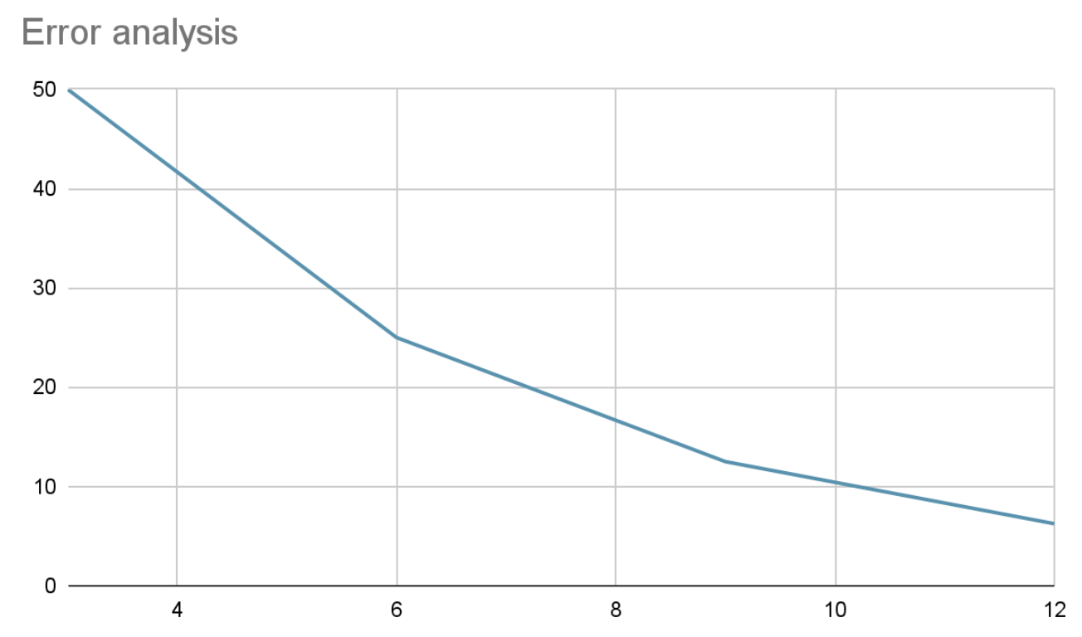
History of a project
Rate of previous improvement
HLP
Notes:
Rate of previous improvements can be a good predictor of future improvement
After these many months, the team will reduce the error rate by some percentage relative to HLP

Slide 187
Diligence on value
MLE metrics
Business
metrics
Notes:
ML engineers are used to optimizing some metrics
Business owners want to optimize other metrics
There is often a gap between two
For some businesses, query-level acc is more important than word-level
Good search results and user engagement => user will come back to the search engine
Engg team wants to work on word-level accuracy, whereas business leader wants promises on Revenue

Slide 188
Diligence on value
MLE metrics
Business
metrics
Word-level accuray
Notes:
ML engineers are used to optimizing some metrics
Business owners want to optimize other metrics
There is often a gap between two
For some businesses, query-level acc is more important than word-level
Good search results and user engagement => user will come back to the search engine
Engg team wants to work on word-level accuracy, whereas business leader wants promises on Revenue

Slide 189
Diligence on value
MLE metrics
Business
metrics
Word-level accuray
Query-level
accuracy
Notes:
ML engineers are used to optimizing some metrics
Business owners want to optimize other metrics
There is often a gap between two
For some businesses, query-level acc is more important than word-level
Good search results and user engagement => user will come back to the search engine
Engg team wants to work on word-level accuracy, whereas business leader wants promises on Revenue

Slide 190
Diligence on value
MLE metrics
Business
metrics
Word-level accuray
Query-level
accuracy
Search result quality
Notes:
ML engineers are used to optimizing some metrics
Business owners want to optimize other metrics
There is often a gap between two
For some businesses, query-level acc is more important than word-level
Good search results and user engagement => user will come back to the search engine
Engg team wants to work on word-level accuracy, whereas business leader wants promises on Revenue

Slide 191
Diligence on value
MLE metrics
Business
metrics
Word-level accuray
Query-level
accuracy
Search result quality
User engagement
Notes:
ML engineers are used to optimizing some metrics
Business owners want to optimize other metrics
There is often a gap between two
For some businesses, query-level acc is more important than word-level
Good search results and user engagement => user will come back to the search engine
Engg team wants to work on word-level accuracy, whereas business leader wants promises on Revenue

Slide 192
Diligence on value
MLE metrics
Business
metrics
Word-level accuray
Query-level
accuracy
Search result quality
User engagement
Revenue
Notes:
ML engineers are used to optimizing some metrics
Business owners want to optimize other metrics
There is often a gap between two
For some businesses, query-level acc is more important than word-level
Good search results and user engagement => user will come back to the search engine
Engg team wants to work on word-level accuracy, whereas business leader wants promises on Revenue

Slide 193
Diligence on value
MLE metrics
Business
metrics
Word-level accuray
Query-level
accuracy
Search result quality
User engagement
Revenue
Notes:
ML engineers are used to optimizing some metrics
Business owners want to optimize other metrics
There is often a gap between two
For some businesses, query-level acc is more important than word-level
Good search results and user engagement => user will come back to the search engine
Engg team wants to work on word-level accuracy, whereas business leader wants promises on Revenue
In order for project to move forward

Slide 194
Diligence on value
Have technical and business team to agree on metrics that both are comfortable with.
MLE metrics
Business
metrics
Word-level accuray
Query-level
accuracy
Search result quality
User engagement
Revenue
Notes:
ML engineers are used to optimizing some metrics
Business owners want to optimize other metrics
There is often a gap between two
For some businesses, query-level acc is more important than word-level
Good search results and user engagement => user will come back to the search engine
Engg team wants to work on word-level accuracy, whereas business leader wants promises on Revenue
In order for project to move forward

Slide 195
Diligence on value
Have technical and business team to agree on metrics that both are comfortable with.
MLE metrics
Business
metrics
Word-level accuray
Query-level
accuracy
Search result quality
User engagement
Revenue
Notes:
ML engineers are used to optimizing some metrics
Business owners want to optimize other metrics
There is often a gap between two
For some businesses, query-level acc is more important than word-level
Good search results and user engagement => user will come back to the search engine
Engg team wants to work on word-level accuracy, whereas business leader wants promises on Revenue
In order for project to move forward
The further we go to the right, the harder it is for ML team to really give a guarantee
I wish more problems could be solved by gradient descent or by optimizing test set acc
But that’s just not state of the world today
A lot of practical problems require more effort

Slide 196
Ethical considerations
Is this project creating net positive societal value?
Is this project reasonably fair and free from bias?
Have any ethical concerns been openly aired and debated?
Notes:
Issues of values and ethics are very domain dependent
Different for loan request vs. medical vs. recommender
Look for ethical frameworks that have been developed in your industry

Slide 197
Milestones and Resourcing
Key specifications
ML metrics (accuracy, precision ,recal, etc.)
Software metrics (latency, throughput, etc. given compute resources)
Business metrics (revenue, etc.)
Resources needed (data, personnel, help from other teams)
Timeline (for achieving goals and milestones)
If unsure
Consider benchmarking to other similar projects (done by other people)
Work on POC (Proof of Concept) first to get sense of feasibility
Notes:
Then use this POC info to more confidently scope out the milestones and resources needed for large scale execution of the project

Slide 198
That’s all!
Notes:
That’s all from the ML lifecyle section (for now)
Now I would like to show a bit about an MLOps tool (ClearML)
Any comments before we move on?

Slide 199
ClearML
Notes:
That’s all from the ML lifecyle section (for now)
Now I would like to show a bit about an MLOps tool (ClearML)
Any comments before we move on?

Slide 200
What is ClearML?
It is an end-to-end MLOps suite
Ensures your work is reproducible and scalable
Notes:
ClearML is an open source platform that automates and simplifies developing and managing machine learning solutions
It is designed as an end-to-end MLOps suite allowing you to focus on developing your ML code & automation, while ClearML ensures your work is reproducible and scalable.

Slide 201
What can you do with ClearML?
Track and upload metrics and models with only 2 lines of code
Notes:
ClearML is an open source platform that automates and simplifies developing and managing machine learning solutions
It is designed as an end-to-end MLOps suite allowing you to focus on developing your ML code & automation, while ClearML ensures your work is reproducible and scalable.

Slide 202
What can you do with ClearML?
Track and upload metrics and models with only 2 lines of code
Reproduce experiments with 3 mouse clicks
Notes:
ClearML is an open source platform that automates and simplifies developing and managing machine learning solutions
It is designed as an end-to-end MLOps suite allowing you to focus on developing your ML code & automation, while ClearML ensures your work is reproducible and scalable.

Slide 203
What can you do with ClearML?
Track and upload metrics and models with only 2 lines of code
Reproduce experiments with 3 mouse clicks
Create bots that send you Slack messages based on experiment behavior (for example, alert you whenever your model improves in accuracy)
Notes:
ClearML is an open source platform that automates and simplifies developing and managing machine learning solutions
It is designed as an end-to-end MLOps suite allowing you to focus on developing your ML code & automation, while ClearML ensures your work is reproducible and scalable.

Slide 204
What can you do with ClearML?
Track and upload metrics and models with only 2 lines of code
Reproduce experiments with 3 mouse clicks
Create bots that send you Slack messages based on experiment behavior (for example, alert you whenever your model improves in accuracy)
Manage your data - store, track, and version control
Notes:
ClearML is an open source platform that automates and simplifies developing and managing machine learning solutions
It is designed as an end-to-end MLOps suite allowing you to focus on developing your ML code & automation, while ClearML ensures your work is reproducible and scalable.

Slide 205
What can you do with ClearML?
Track and upload metrics and models with only 2 lines of code
Reproduce experiments with 3 mouse clicks
Create bots that send you Slack messages based on experiment behavior (for example, alert you whenever your model improves in accuracy)
Manage your data - store, track, and version control
Remotely execute experiments on any compute resource you have available with ClearML Agent
Notes:
ClearML is an open source platform that automates and simplifies developing and managing machine learning solutions
It is designed as an end-to-end MLOps suite allowing you to focus on developing your ML code & automation, while ClearML ensures your work is reproducible and scalable.

Slide 206
What can you do with ClearML?
Track and upload metrics and models with only 2 lines of code
Reproduce experiments with 3 mouse clicks
Create bots that send you Slack messages based on experiment behavior (for example, alert you whenever your model improves in accuracy)
Manage your data - store, track, and version control
Remotely execute experiments on any compute resource you have available with ClearML Agent
Automatically scale cloud instances according to your resource needs with ClearML's GPU Compute, AWS Autoscaler, and GCP Autoscaler GUI applications!
Notes:
ClearML is an open source platform that automates and simplifies developing and managing machine learning solutions
It is designed as an end-to-end MLOps suite allowing you to focus on developing your ML code & automation, while ClearML ensures your work is reproducible and scalable.

Slide 207
What can you do with ClearML?
Track and upload metrics and models with only 2 lines of code
Reproduce experiments with 3 mouse clicks
Create bots that send you Slack messages based on experiment behavior (for example, alert you whenever your model improves in accuracy)
Manage your data - store, track, and version control
Remotely execute experiments on any compute resource you have available with ClearML Agent
Automatically scale cloud instances according to your resource needs with ClearML's GPU Compute, AWS Autoscaler, and GCP Autoscaler GUI applications
Run hyperparameter optimization
Build pipelines from code
Notes:
ClearML is an open source platform that automates and simplifies developing and managing machine learning solutions
It is designed as an end-to-end MLOps suite allowing you to focus on developing your ML code & automation, while ClearML ensures your work is reproducible and scalable.

Slide 208
What can you do with ClearML?
Track and upload metrics and models with only 2 lines of code
Reproduce experiments with 3 mouse clicks
Create bots that send you Slack messages based on experiment behavior (for example, alert you whenever your model improves in accuracy)
Manage your data - store, track, and version control
Remotely execute experiments on any compute resource you have available with ClearML Agent
Automatically scale cloud instances according to your resource needs with ClearML's GPU Compute, AWS Autoscaler, and GCP Autoscaler GUI applications
Run hyperparameter optimization
Build pipelines from code
Much more!
Notes:
ClearML is an open source platform that automates and simplifies developing and managing machine learning solutions
It is designed as an end-to-end MLOps suite allowing you to focus on developing your ML code & automation, while ClearML ensures your work is reproducible and scalable.

Slide 209
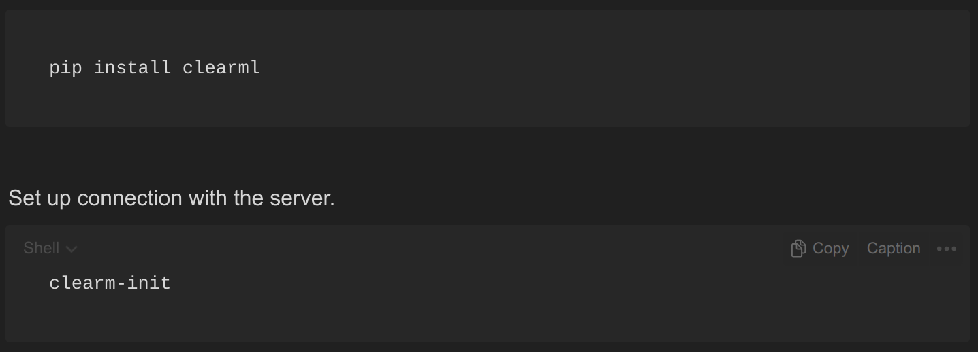
Setup and usage

Slide 210
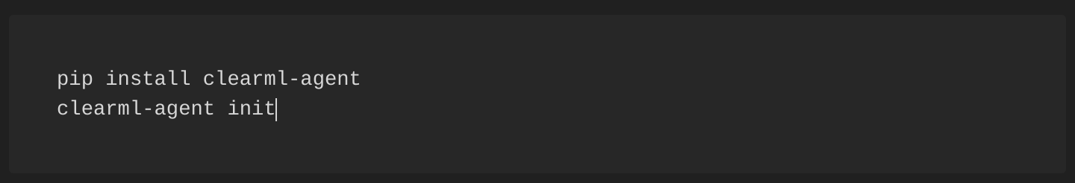
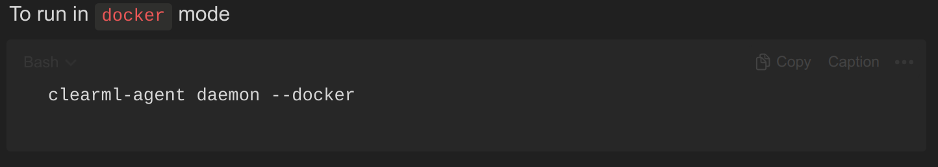
Setup and usage
Use agent to execute tasks remotely
Agent can run in pip, conda, poetry and docker mode.

Slide 211
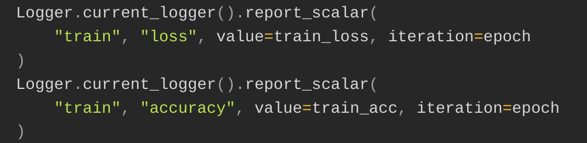
Setup and usage
Log scalars

Slide 212
Setup and usage
Rest in my reports and repo
Also checkout introduction videos by ClearML team their documentation
Next
UI
Notes:
We have other options
I am currently exploring ClearML
Soon I am gonna shift and explore MLFlow which is another famous framework
Then I will try to standardize a bit
Next I will show you the actual UI
But before that

Slide 213
Thank you!
Notes:
Let’s take a brief look at ClearML UI

